Slide 1
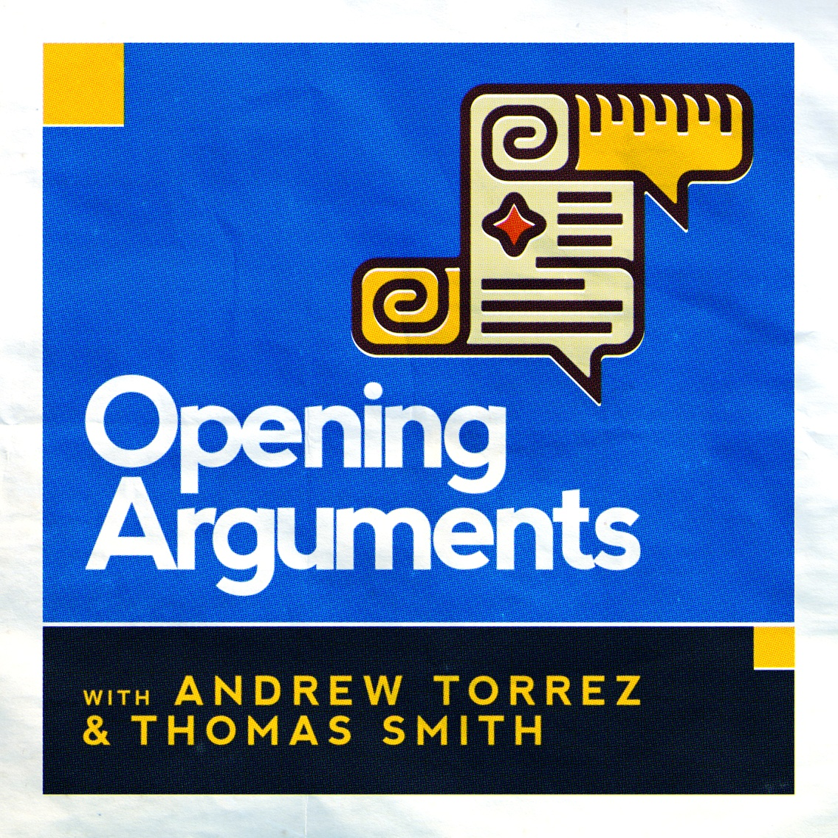
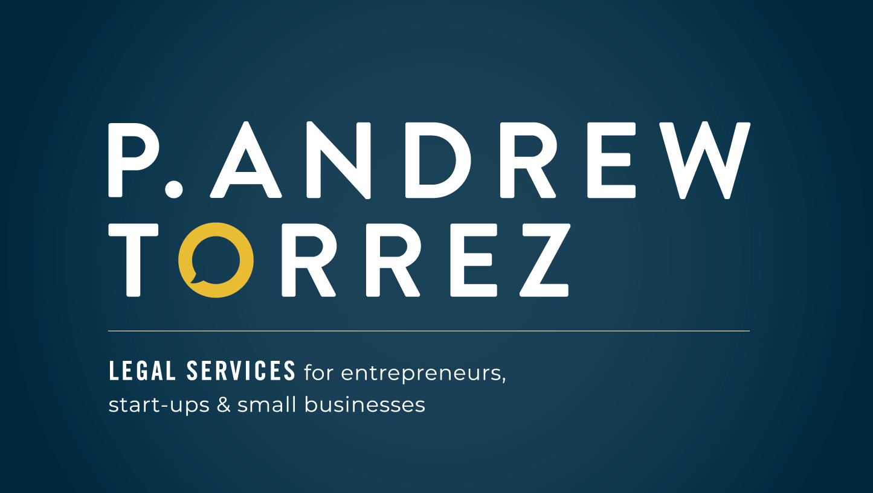
Skepticism and Existential Threats in the Age of Fake News
www.patorrez.com

Slide 2
WE’RE ALL GONNA DIE!!!!!!!!!!!!!!!! (And probably* not from COVID-19)
www.patorrez.com

Slide 3
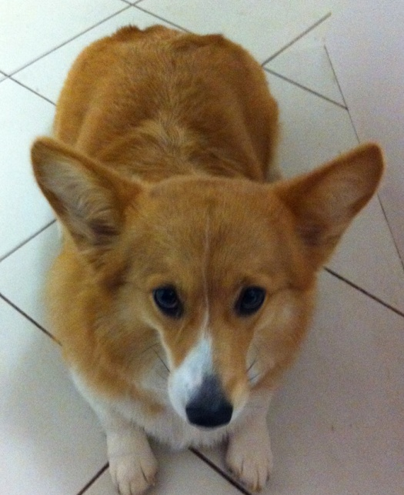
DISCLAIMERS
Skeptics in the Pub-Online is a coalition of UK-based skeptics groups working to deliver online events focusing on science, reason, and critical thinking. Nothing in this speech is, or is intended to, advocate on behalf of or in opposition to any political campaign or any candidate for public office in any country.
Nothing in this speech constitutes legal advice or creates an attorney-client relationship.
Don’t take legal advice from this speech!

Slide 4
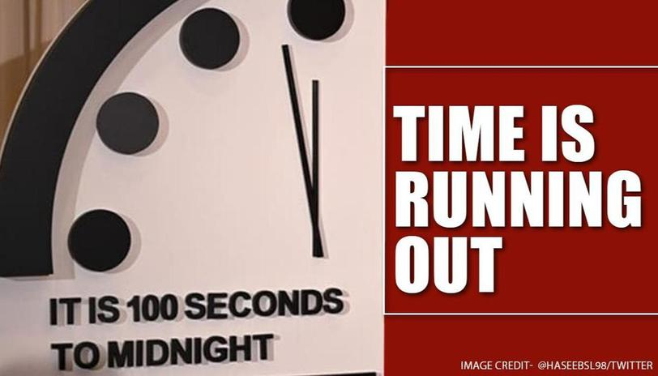

Slide 6
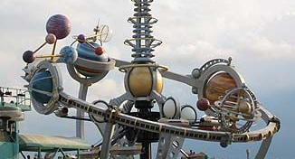

Slide 8
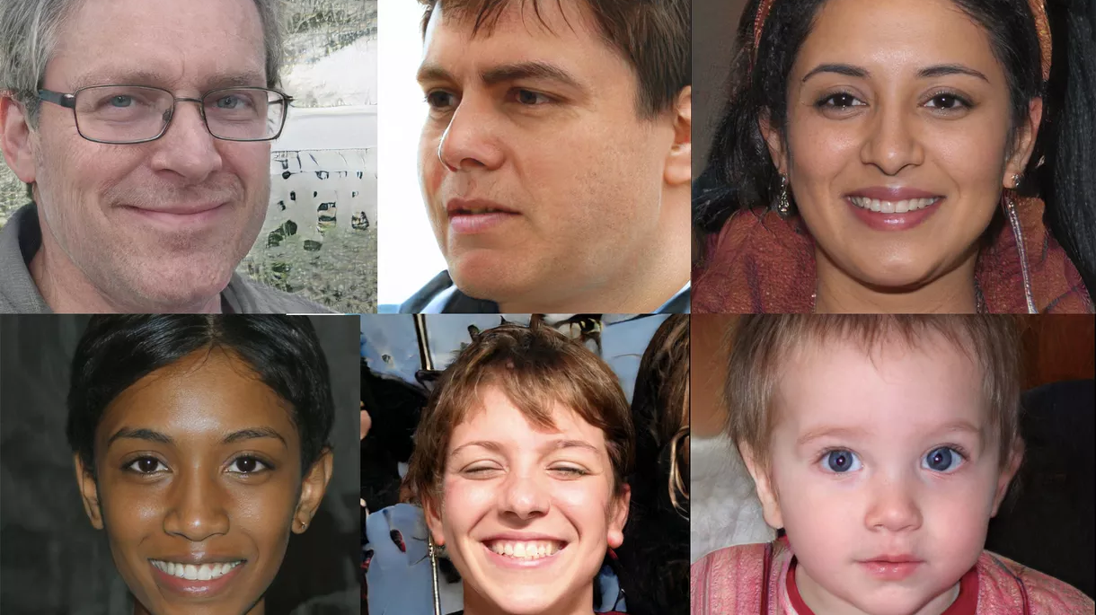
What do all these people have in common?

Slide 10
None of them are real.

Slide 11
www.thispersondoesnotexist.com

Slide 12
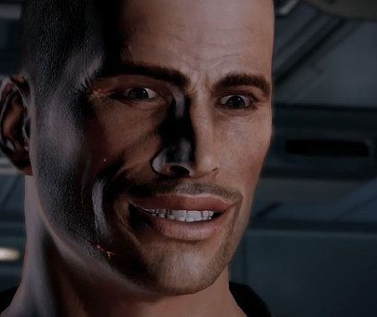
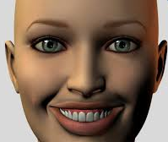
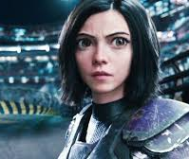
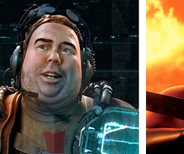
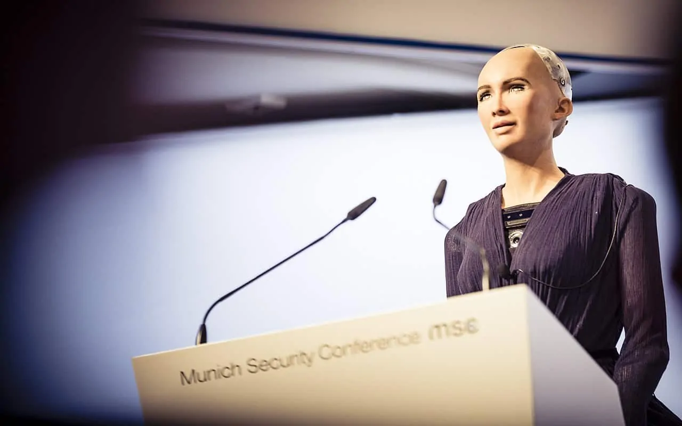

Slide 13
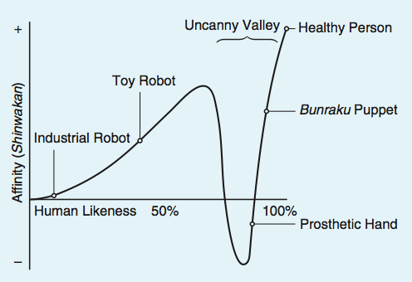
The “Uncanny Valley”
Masahiro Mori, Energy, 1970
https://spectrum.ieee.org/automaton/robotics/humanoids/the-uncanny-valley

Slide 15
The “Uncanny Valley”
Masahiro Mori, Energy, 1970
We Can’t Make Things That Look Entirely Like Ourselves.
https://spectrum.ieee.org/automaton/robotics/humanoids/the-uncanny-valley

Slide 16
The “Uncanny Valley”
Masahiro Mori, Energy, 1970
We Can’t Make Things That Look Entirely Like Ourselves.
We’re Very, Very Good at Detecting Those Tiny Differences Between the Real and the Unreal.
https://spectrum.ieee.org/automaton/robotics/humanoids/the-uncanny-valley

Slide 17
The “Uncanny Valley”
Masahiro Mori, Energy, 1970
We Can’t Make Things That Look Entirely Like Ourselves.
We’re Very, Very Good at Detecting Those Tiny Differences Between the Real and the Unreal.
AI Doesn’t Give a Shit.
https://spectrum.ieee.org/automaton/robotics/humanoids/the-uncanny-valley

Slide 19
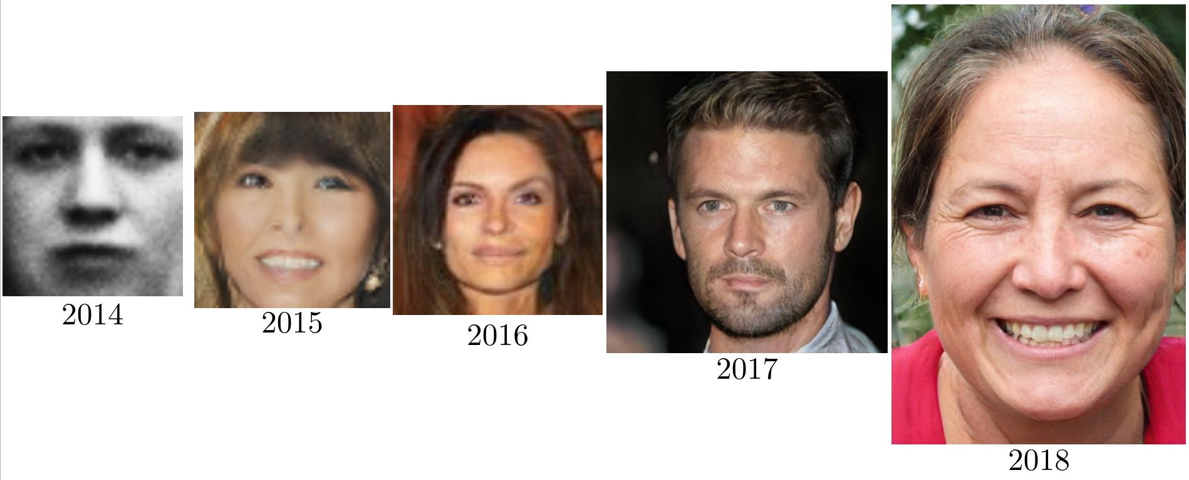
https://www.vox.com/future-perfect/2019/5/31/18645993/ai-deepfakes-gan-explained-machine-learning

Slide 20
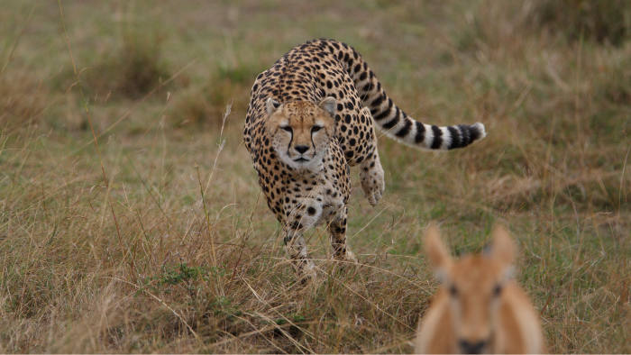
“The arms race between predators and prey is asymmetric, in which success on either side is felt as failure by the other side, but the nature of the success and failure on the two sides is very different. The two sides are 'trying' to do very different things. Predators are trying to eat prey. Prey are not trying to eat predators; they are trying to avoid being eaten by predators. From an evolutionary point of view asymmetric arms races are more likely to generate highly complex weapons systems.”
― Richard Dawkins, The Blind Watchmaker

Slide 21
https://www.vox.com/future-perfect/2019/5/31/18645993/ai-deepfakes-gan-explained-machine-learning

Slide 23
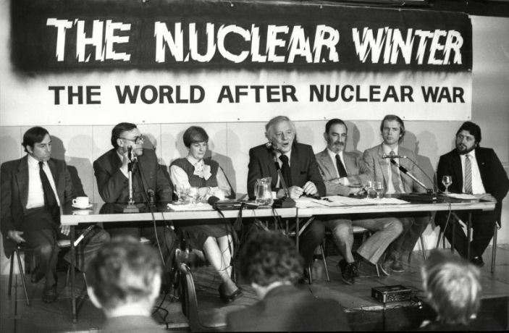
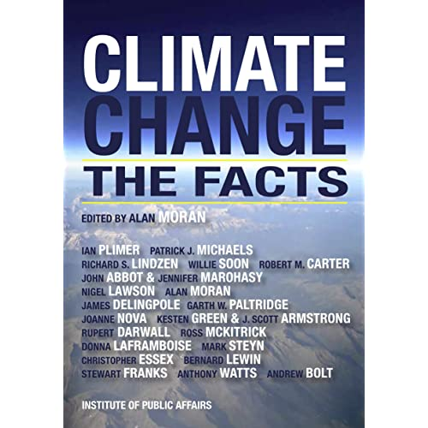
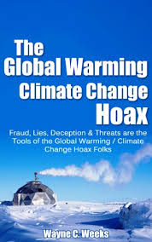
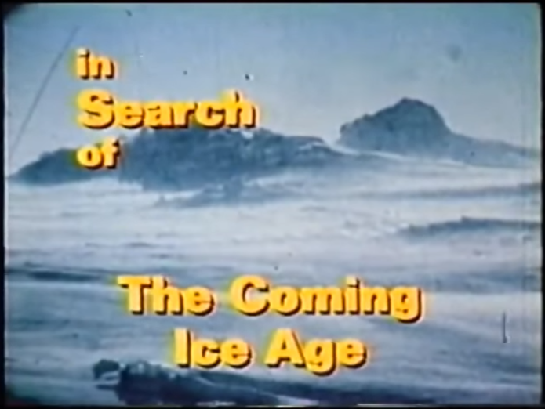
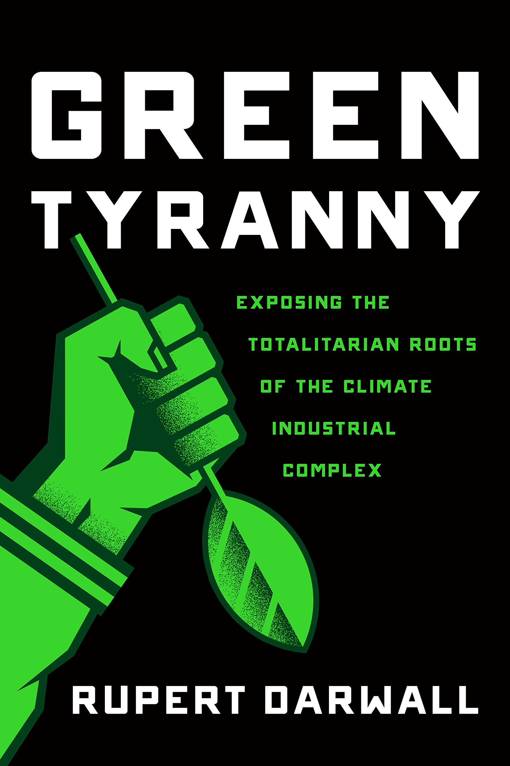
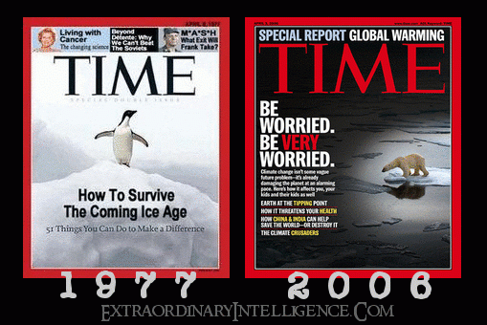

Slide 24
http://climate.envsci.rutgers.edu/robock/robock_res.html#nw

Slide 26
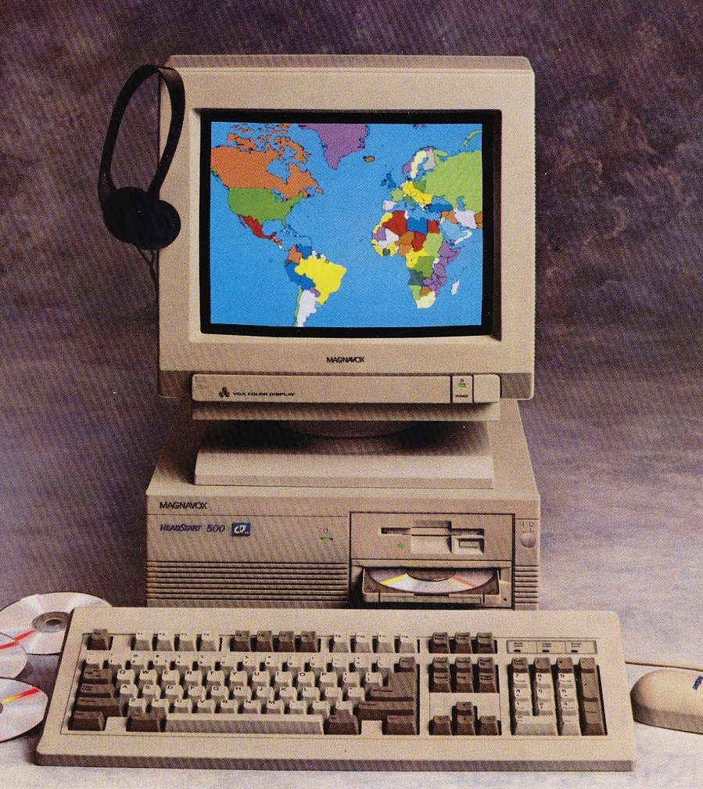
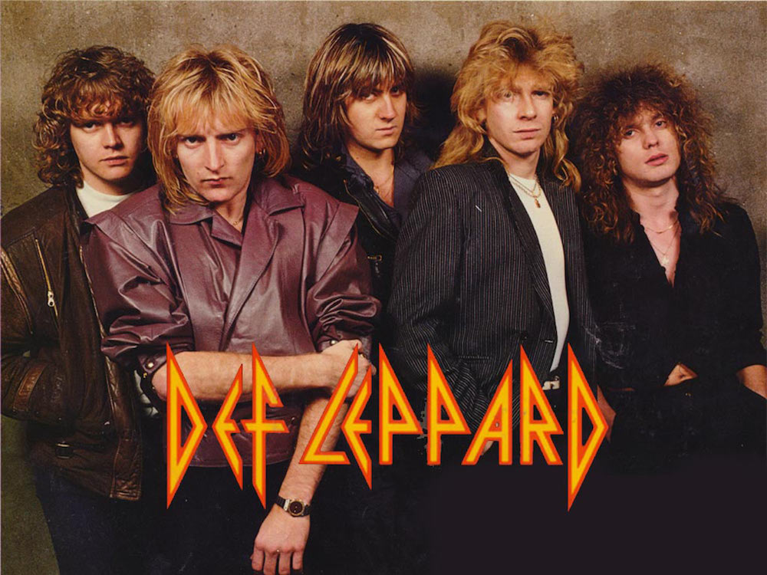

Slide 27
17

Slide 28
14

Slide 29
9

Slide 30
7

Slide 31
5

Slide 32
6

Slide 33
5

Slide 34
3

Slide 35
2 ½

Slide 36
2

Slide 37
100 seconds

Slide 38
Bulletin of the Atomic Scientists - January 23, 2020
“The world is sleepwalking its way through a newly unstable nuclear landscape.”
“[T]he international political infrastructure is degrading.”
“The global security situation is unsustainable and extremely dangerous….”

Slide 39
Bulletin of the Atomic Scientists - January 23, 2020
“In recent years, national leaders have increasingly dismissed information with which they do not agree as fake news, promulgating their own untruths, exaggerations, and misrepresentations in response. Unfortunately, this trend accelerated in 2019. Leaders claimed their lies to be truth, calling into question the integrity of, and creating public distrust in, national institutions that have historically provided societal stability and cohesion. In the United States, there is active political antagonism toward science and a growing sense of government-sanctioned disdain for expert opinion, creating fear and doubt regarding well-established science about climate change and other urgent challenges. Countries have long attempted to employ propaganda in service of their political agendas. Now, however, the internet provides widespread, inexpensive access to worldwide audiences, facilitating the broadcast of false and manipulative messages to large populations and enabling millions of individuals to indulge in their prejudices, biases, and ideological differences. The recent emergence of so-called “deepfakes”—audio and video recordings that are essentially undetectable as false—threatens to further undermine the ability of citizens and decision makers to separate truth from fiction.”

Slide 40
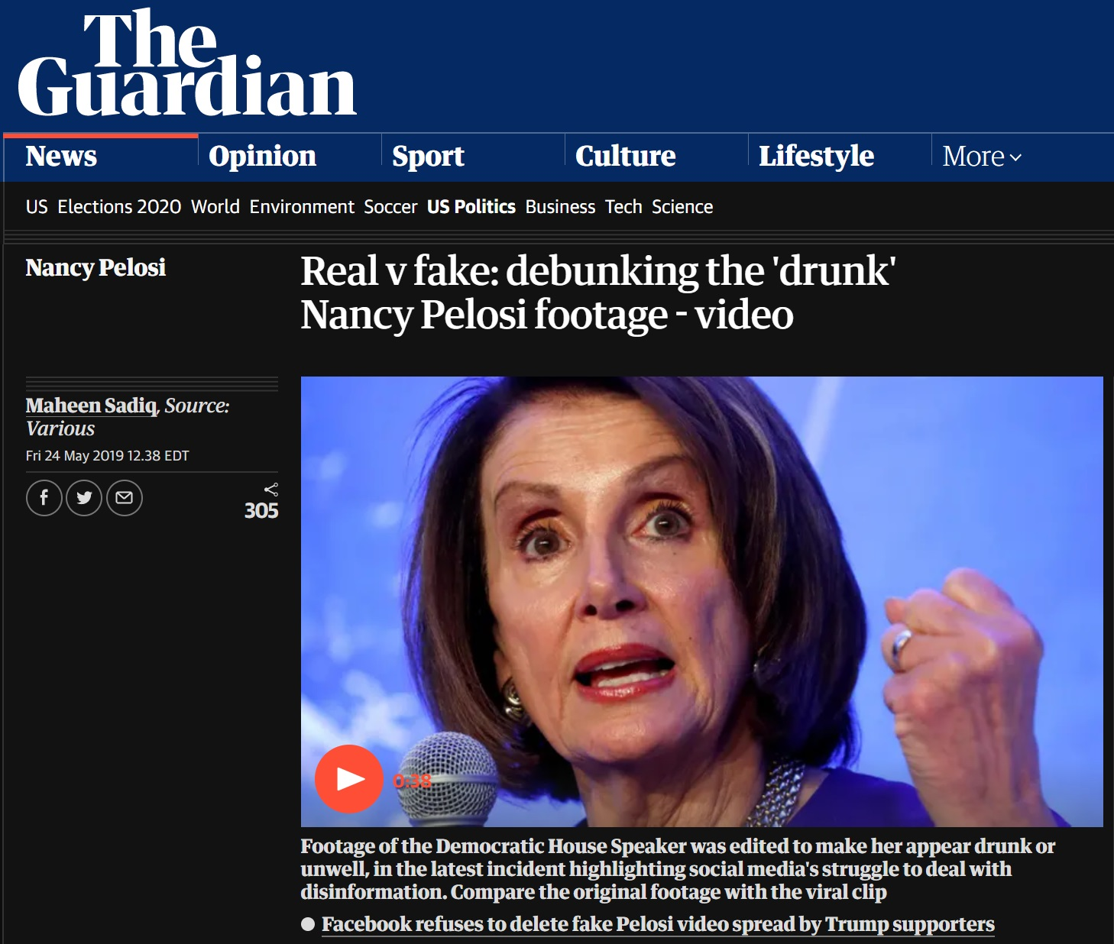

Slide 42
Human Rights Act of 1998 - Article 10
1. Everyone has the right to freedom of expression. This right shall include freedom to hold opinions and to receive and impart information and ideas without interference by public authority and regardless of frontiers. This Article shall not prevent States from requiring the licensing of broadcasting, television or cinema enterprises.
2. The exercise of these freedoms, since it carries with it duties and responsibilities, may be subject to such formalities, conditions, restrictions or penalties as are prescribed by law and are necessary in a democratic society, in the interests of national security, territorial disorder or crime, for the protection of health or morals, for the protection of the reputation or rights of others, for preventing the disclosure of information received in confidence, or for maintaining the authority and impartiality of the judiciary.

Slide 43
Skeptic’s Toolkit
You don’t have to be “FIRST!!@!”

Slide 44
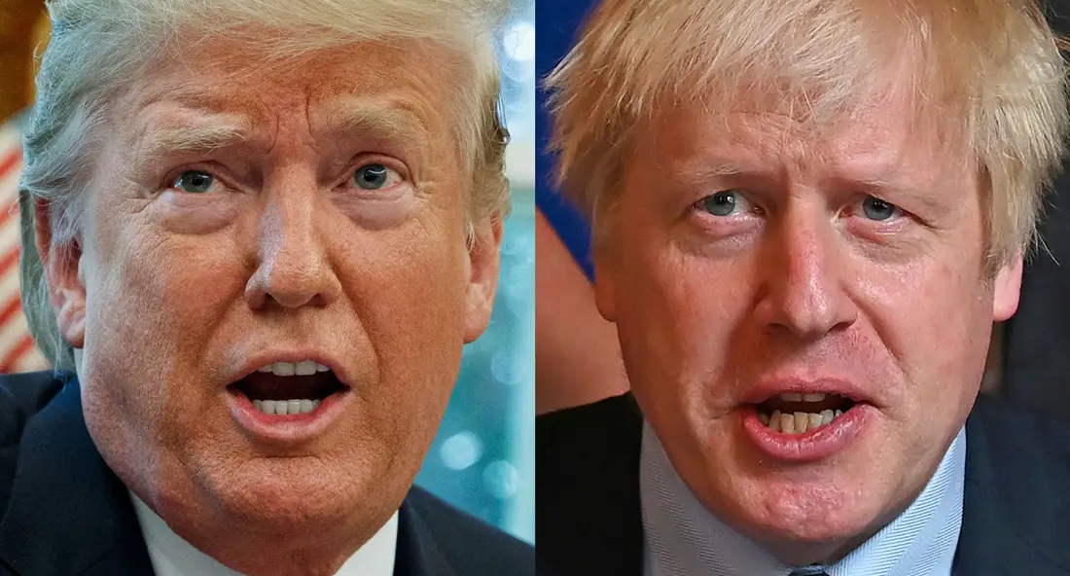

Slide 46
Court Declares Muslim Ban Unconstitutional

Slide 47
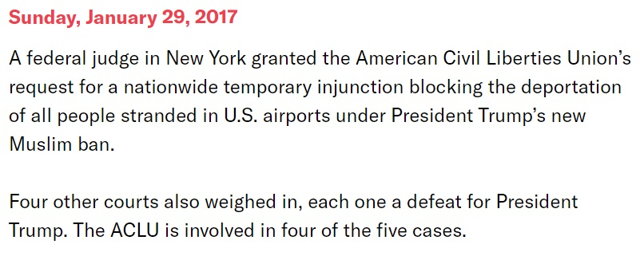
Court Declares Muslim Ban Unconstitutional

Slide 48
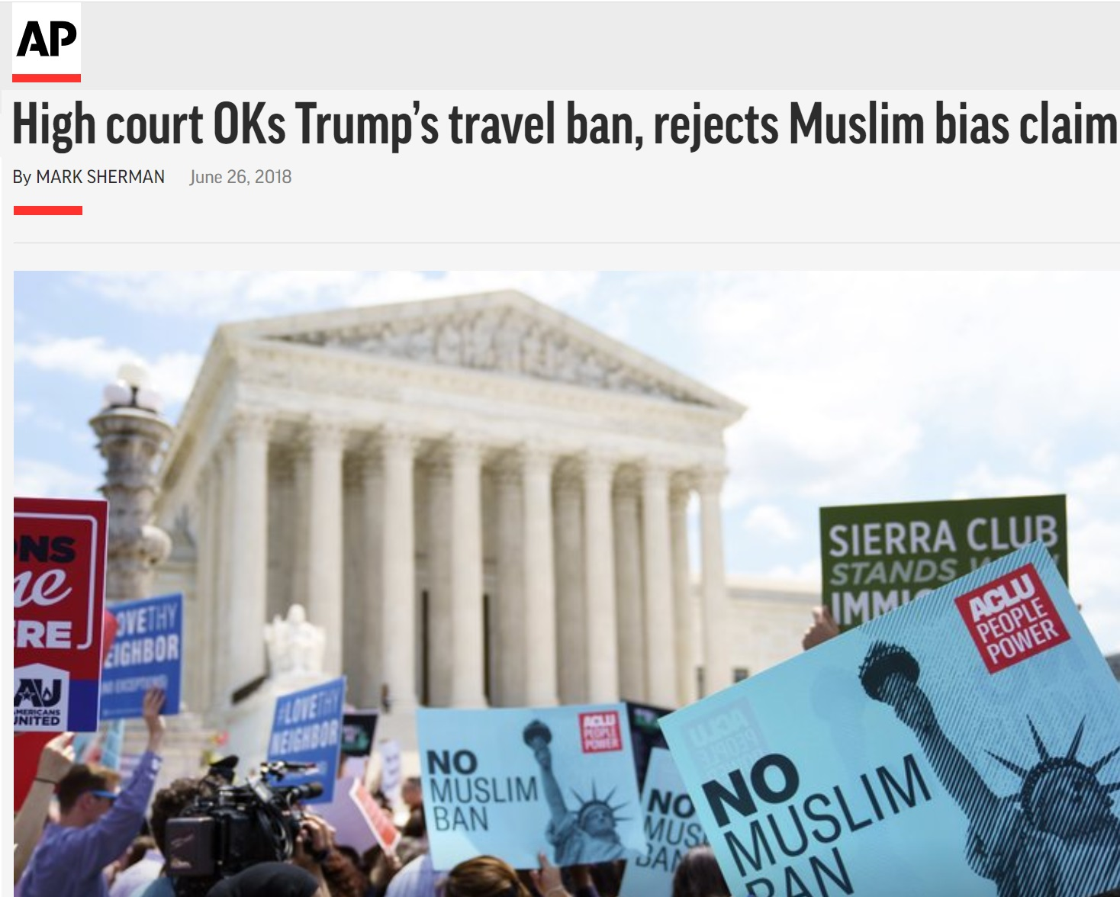

Slide 49
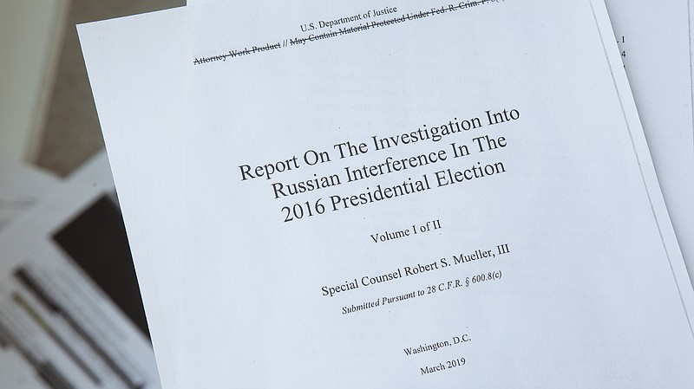

Slide 50
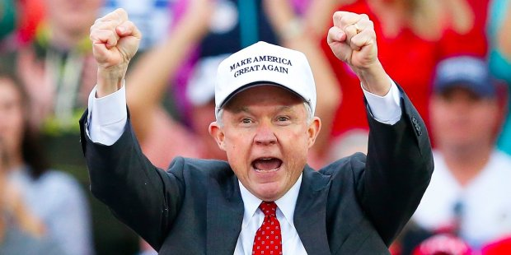

Slide 51
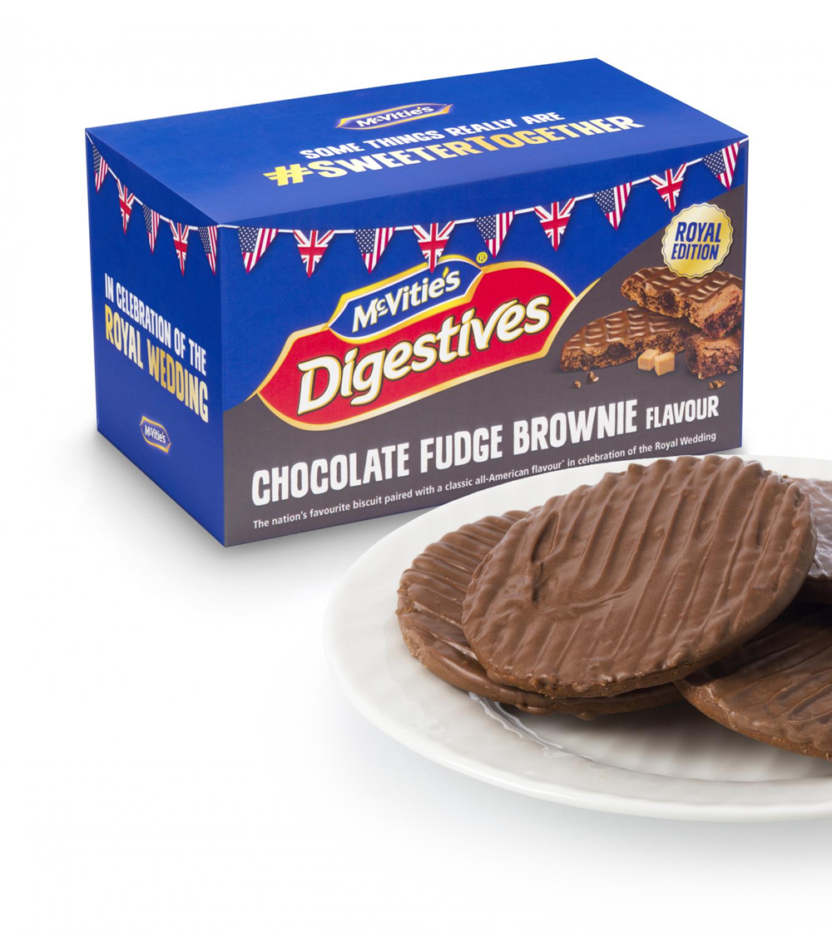

Slide 52
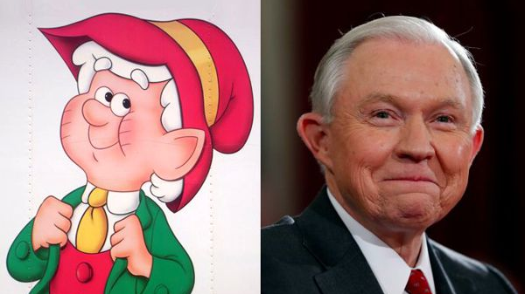

Slide 55
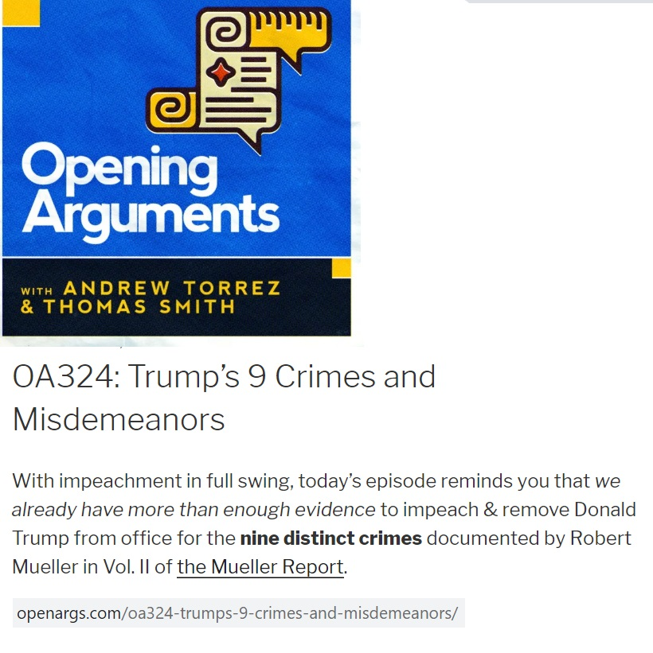

Slide 57
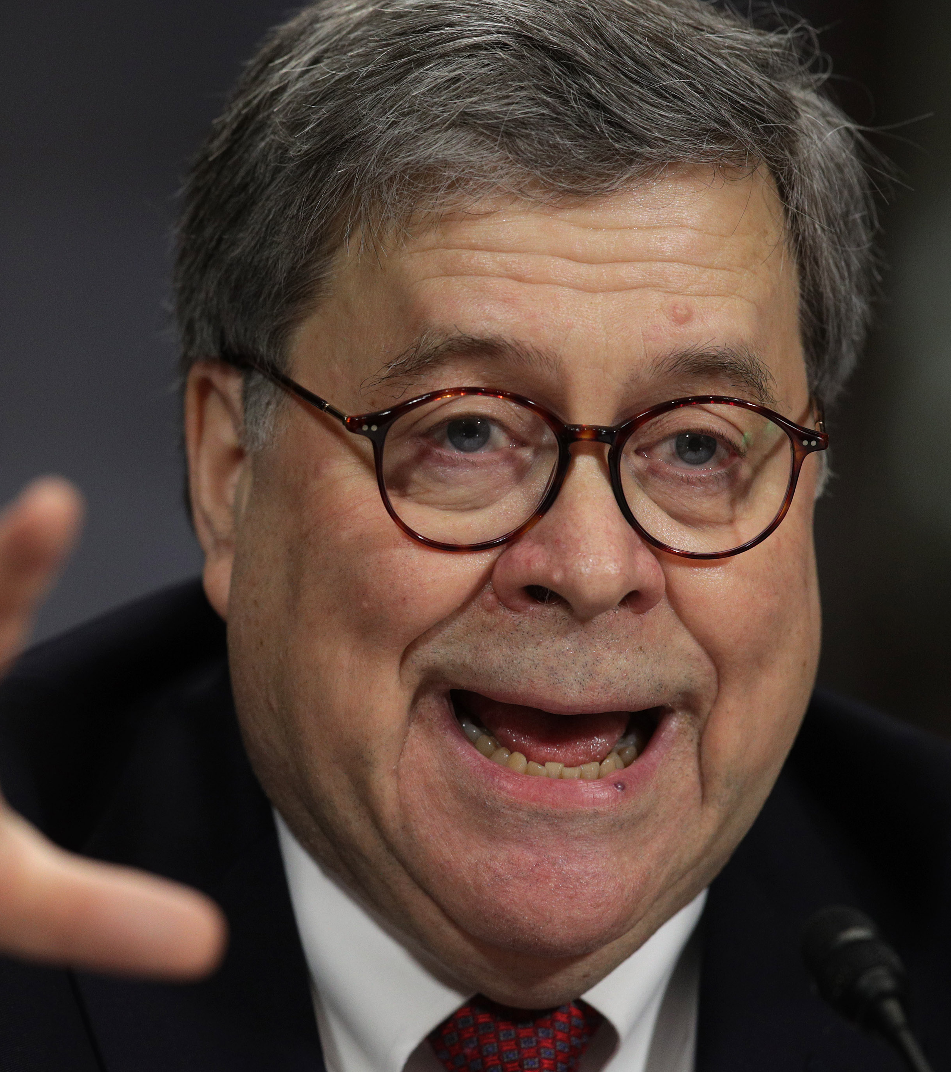
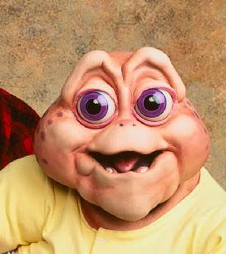

Slide 58
“Below, I summarize the principal conclusions set out in the Special Counsel’s report.”

Slide 59
“Below, I summarize the principal conclusions set out in the Special Counsel’s report.”
“no collusion”

Slide 60
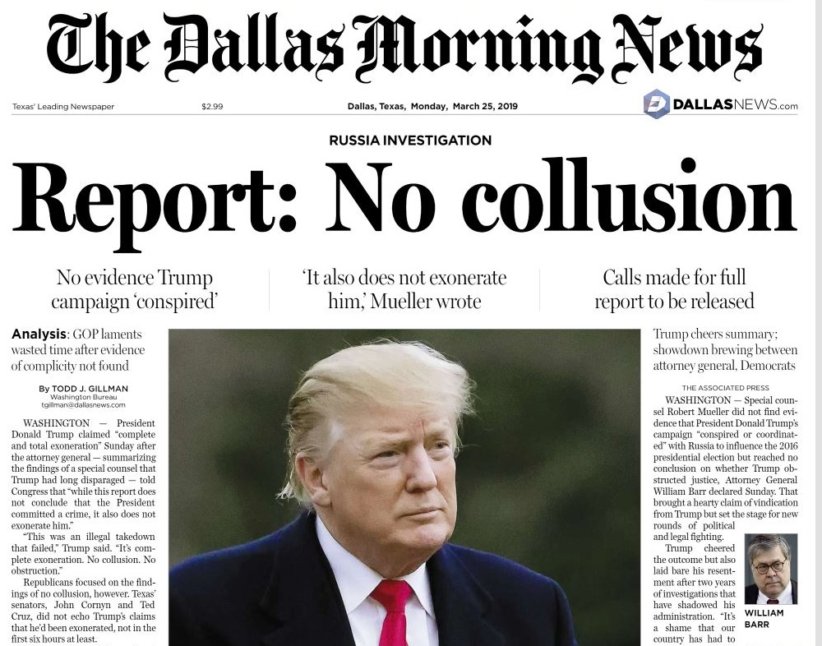

Slide 62
Attorney General Barr’s “Summary”
“[T]he investigation did not establish that members of the Trump Campaign conspired or coordinated with the Russian government in its election interference activities.”
“while this report does not conclude that the President committed a crime, it also does not exonerate him.”
“the evidence does not establish that the President was involved in an underlying crime related to Russian election interference”

Slide 63
Attorney General Barr’s “Summary” – Quote #1:
Although the investigation established that the Russian government perceived it would benefit form a Trump presidency and worked to secure that outcome, and the Campaign expected it would benefit electorally from information stolen and released through Russian efforts, “[T]he investigation did not establish that members of the Trump Campaign conspired or coordinated with the Russian government in its election interference activities.”

Slide 64
Attorney General Barr’s “Summary” – Quote #1:
“Although the investigation established that the Russian government perceived it would benefit form a Trump presidency and worked to secure that outcome, and the Campaign expected it would benefit electorally from information stolen and released through Russian efforts, “[T]he investigation did not establish that members of the Trump Campaign conspired or coordinated with the Russian government in its election interference activities.”

Slide 65
Attorney General Barr’s “Summary”
“At the same time, if we had confidence after a thorough investigation of the facts that the President clearly did not commit obstruction of justice, we would so state. Based on the facts and the applicable legal standards, we are unable to reach that judgment. Accordingly, “while this report does not conclude that the President committed a crime, it also does not exonerate him.”
“In this investigation, “the evidence does not establish that the President was involved in an underlying crime related to Russian election interference.” But the evidence does point to a range of other possible personal motives animating the President’s conduct. These include concerns that continued investigation would call into question the legitimacy of his election”

Slide 66
Attorney General Barr’s “Summary”
“At the same time, if we had confidence after a thorough investigation of the facts that the President clearly did not commit obstruction of justice, we would so state. Based on the facts and the applicable legal standards, we are unable to reach that judgment. Accordingly, “while this report does not conclude that the President committed a crime, it also does not exonerate him.”
“In this investigation, “the evidence does not establish that the President was involved in an underlying crime related to Russian election interference.” But the evidence does point to a range of other possible personal motives animating the President’s conduct. These include concerns that continued investigation would call into question the legitimacy of his election”

Slide 68
Skeptic’s Toolkit
You don’t have to be “FIRST!!@!”
Demand to see the underlying documents
Wait until reputable sources have analyzed those documents
Know that even reputable sources can get it wrong.

Slide 69
Skeptic’s Toolkit
Understand first, argue second

Slide 70
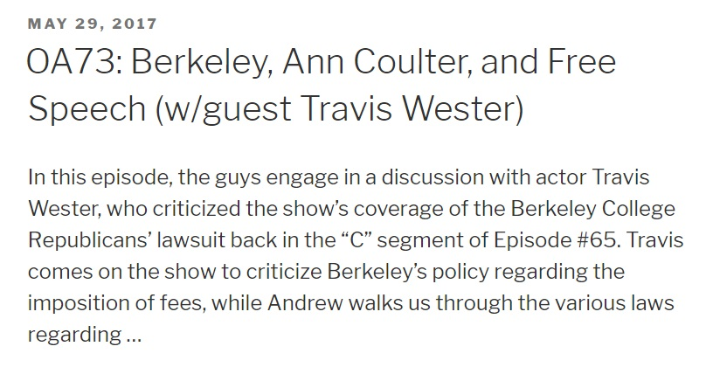
Understand first, argue second
You don’t have to be “FIRST!!@!”

Slide 72
STOP!

Slide 73
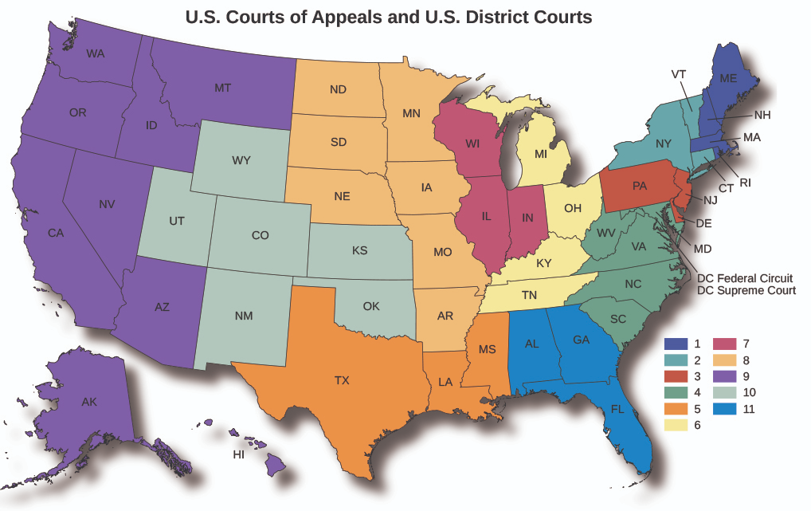

Slide 74
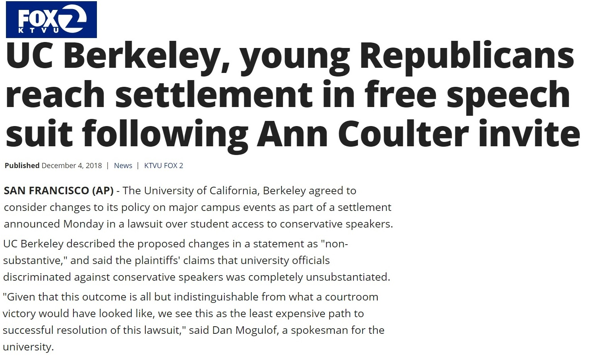

Slide 75
Skeptic’s Toolkit
Understand first, argue second
Don’t try and find facts that fit your argument – understand the facts first and develop your argument second

Slide 76
Skeptic’s Toolkit
Watch out for emotional appeals

Slide 77
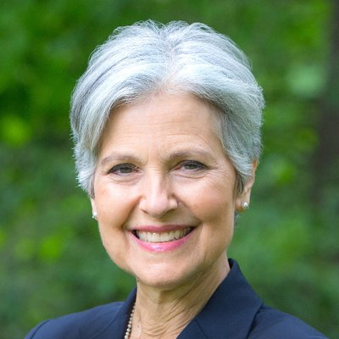
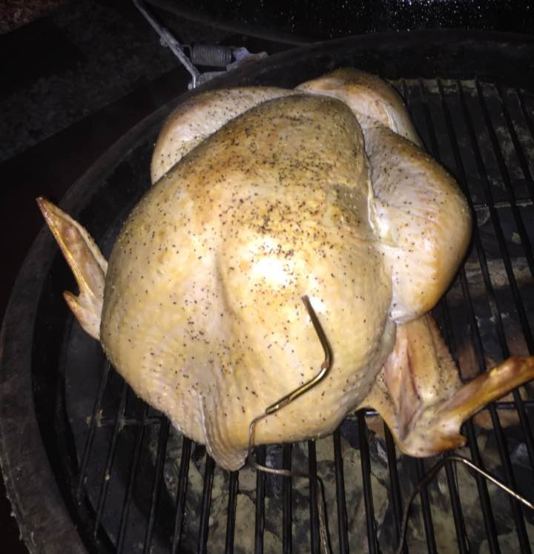

Slide 78
Skeptic’s Toolkit
You don’t have to be “FIRST!!@!”
Understand first, argue second
Watch out for emotional appeals

Slide 80
Skepticism and Existential Threats in the Age of Fake News
www.patorrez.com

