Slide 1
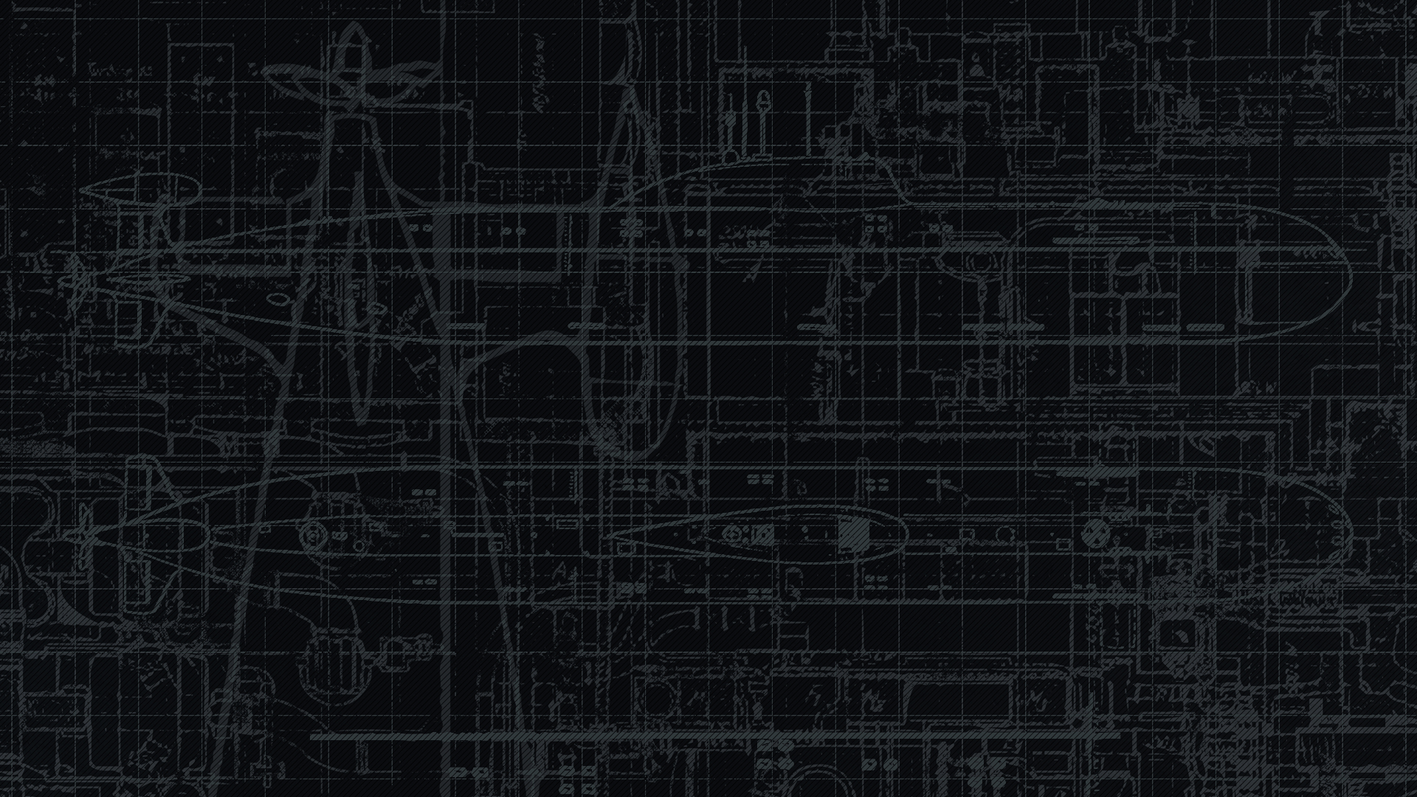
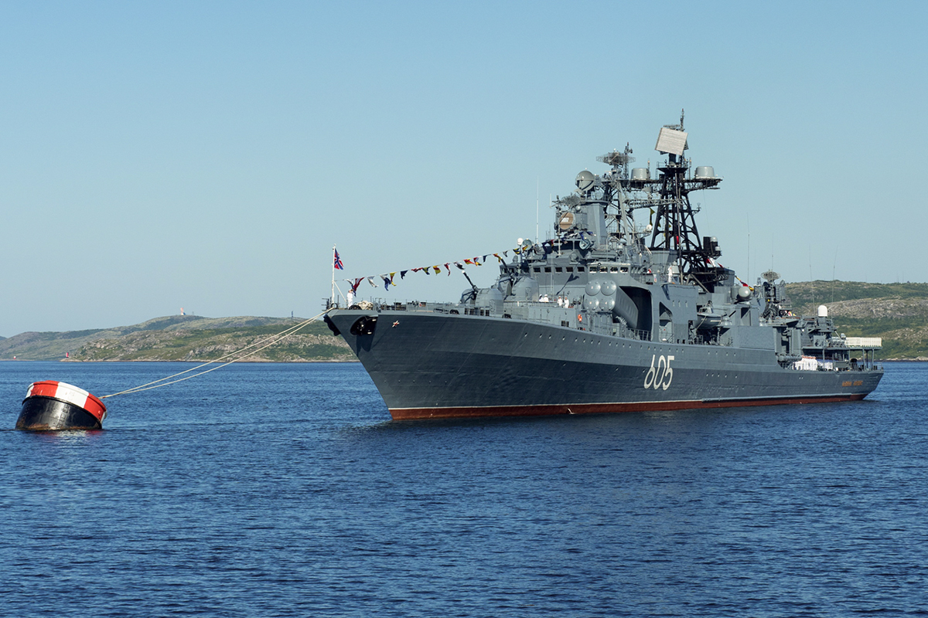
Udaloy DDG
Project 1155 “Fregat”
A Sub Brief

Slide 2
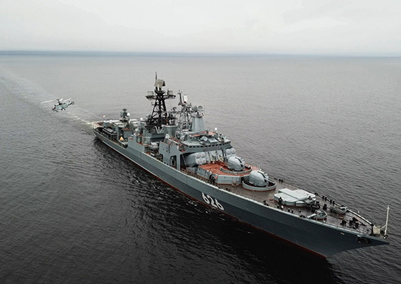
Sources
Globalsecurity.org
Russian Defense Export Roe.ru
Naval technology.com
Shipyard yantar.ru
Aoosk.ru
@JosephHDempsey

Slide 3
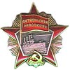

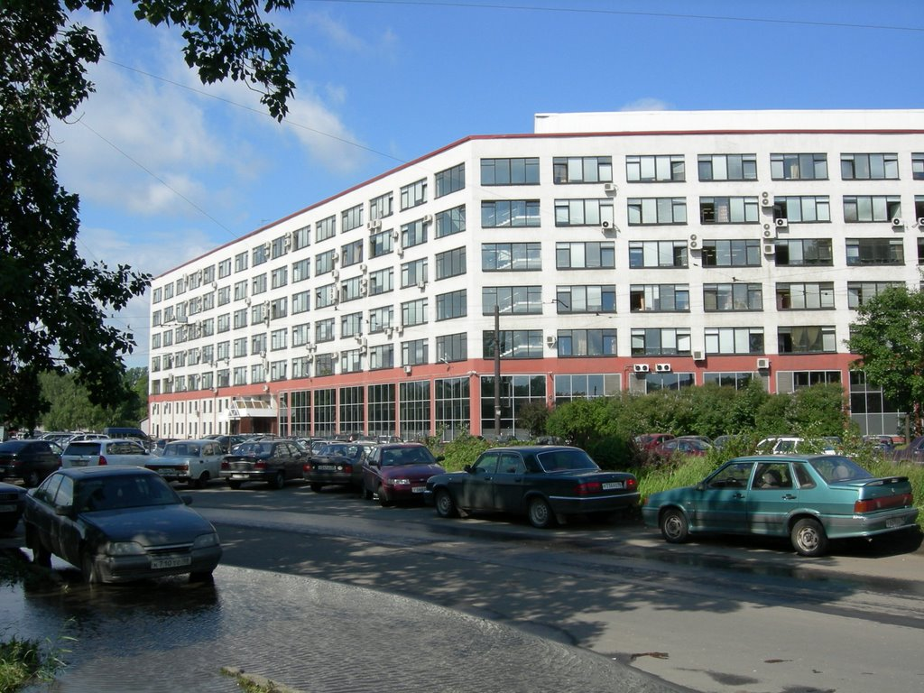
1970 Severnoye Design Bureau
St. Petersburg, Russia
High cost of multipurpose ships lead naval architects to design small specialized warships
Fast, Blue water, submarine hunter
Long range submarine detection and attack capabilities
Compliment the Sovremenny-class Destroyer’s Anti-air and anti-surface role
Construction began in 1977 and lasted through 1999
Assembly took place in severnaya Verf and Yantar shipyards

Slide 4
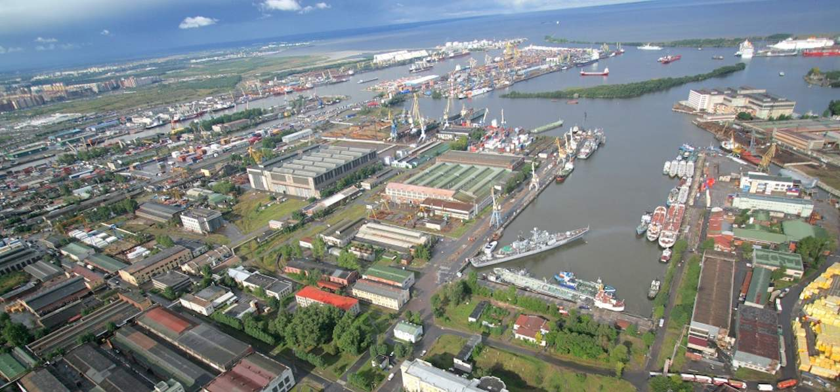

Severnaya Verf shipyard 190
Located in St. Petersburg, Russia
Established in 1890
Builds both military and civilian vessels
Primary export market to India and southeast Asia
8 construction slips, 1 floating drydock and a new ‘large vessel’ drydock

Slide 5
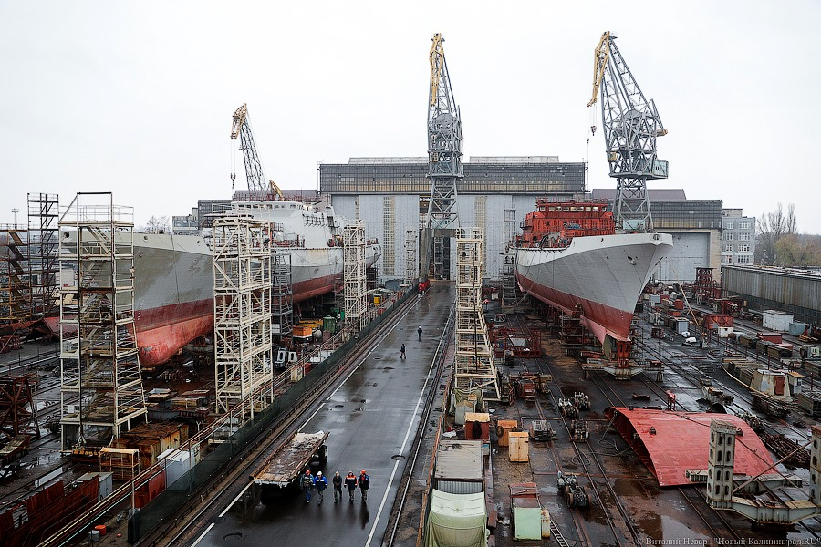
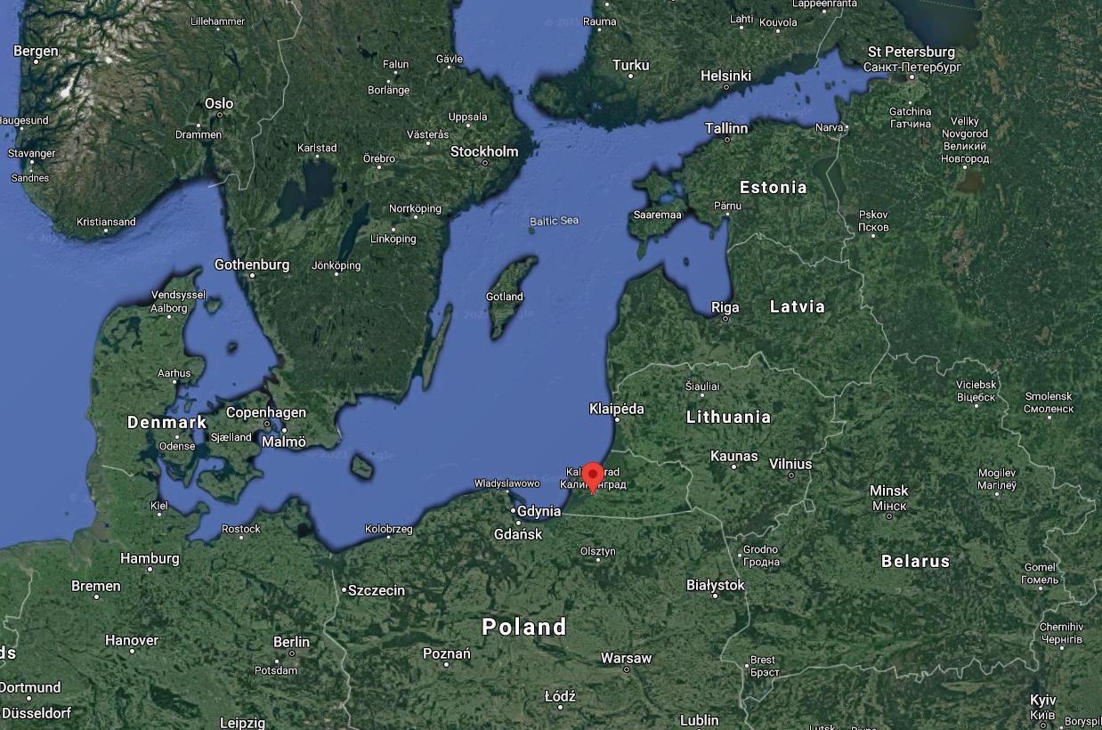

Yantar shipyard
Kaliningrad, Russia
Founded in 1945
Builds military and civilian fishing vessels
Most Udaloys are built here
Most of Russia’s Baltic fleet is based out of Kaliningrad

Slide 6
Udaloy by the numbers
Top Plate 3-d Air search
Strut Pair air/surf search
Horse Jaw bow sonar
Horse Tail towed array
Eye Bowl SSM targeting
Cross Sword SAM control
Bell Shroud Intercept
Bell Crown intercept
Bell squat Jammers
PK-2 and PK-10 Decoys
2 KA-27 Helix ASW helicopters
8400 tons
536 ft long
25.6 ft wide
Combined Gas and Gas
2 M62 cruise GT 15Kshp
2 M8KF boost GT 45Kshp
2 shafts, 5-blades
30 knots, 5k miles
220 crew
8x SS-N-14 Silex launchers
8x Kinzhal VLS Sam Launchers
64 SA-N-9 Gauntlet SAMs
1(or 2*) DP 100mm cannon
2x RBU-6000 ASW bombs
8x 53cm waist torpedo tubes

Slide 7
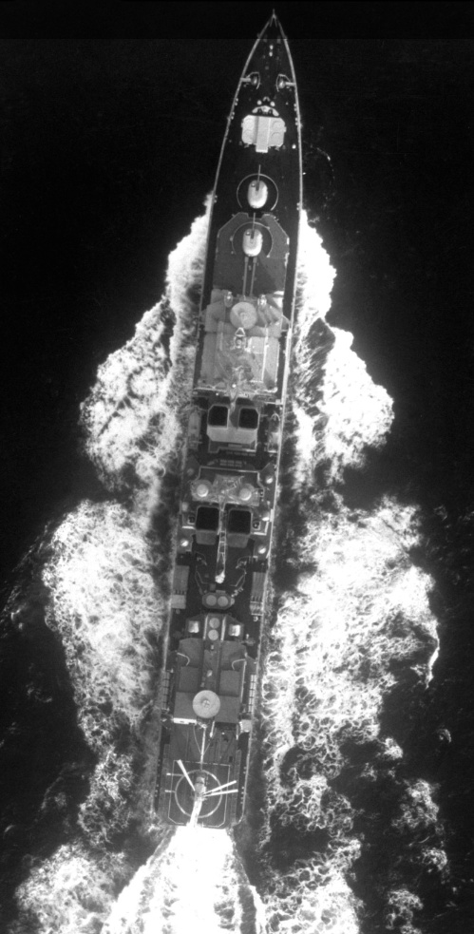
Udaloy “Bold”
Keel laid 23 July 1977
Launched 5 February 1980
Commissioned 31 December 1980
Assigned to the Northern Fleet
1983 Atlantic and Med. Deployment
1984 Cuba visit
1988 to 1990 major overhaul in Kronstadt, St. Petersburg
1993 assigned to fleet reserve due to manning shortage
1997 removed from list of active ships
Decommissioned 2002

Slide 8
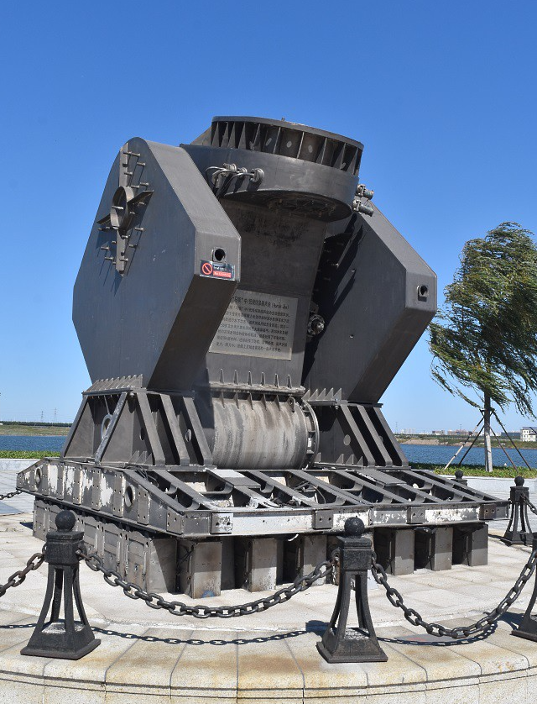
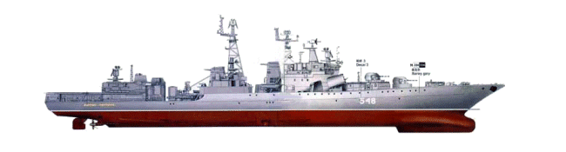
Horse Jaw sonar suite
‘orion’ Bow mounted projector
‘Platina’ stern mounted VDS
LF active, multiple modes, long pulse length >45 seconds
16-mile range scale (estimate)
Shallow water active broadband mode, very effective
LF/MF passive
Horse Tail VDS active and passive 75-mile range scale
Track 16 targets with automated trackers

Slide 9
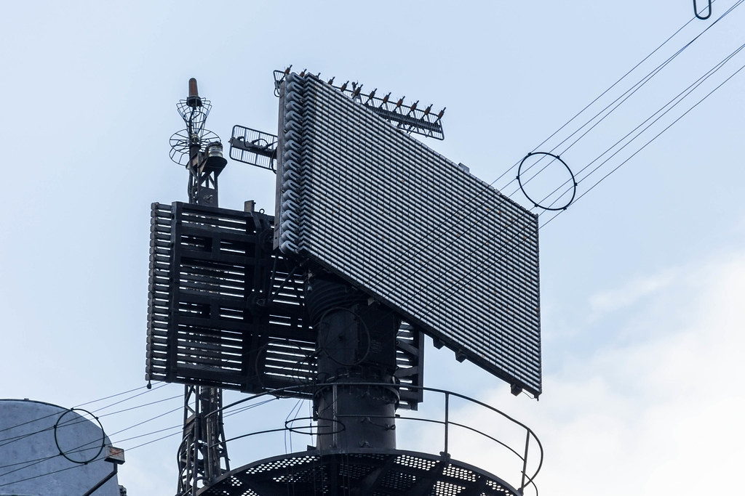
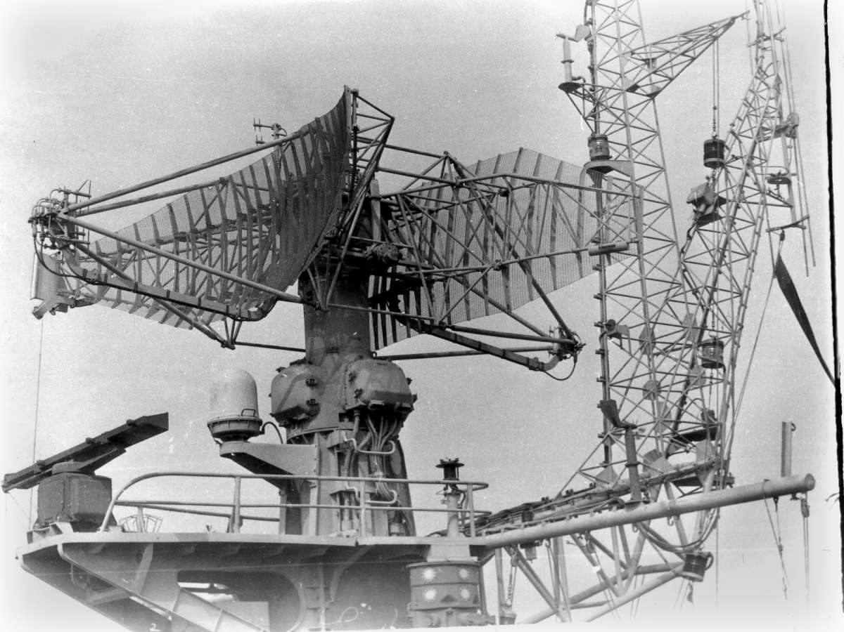
Top Plate and Strut Pair radars
Top Plate
Long range air search
3-D Bearing, Range and Altitude
Air search radar
Strut Pair
Surface search
2-D Bearing and Range

Slide 10
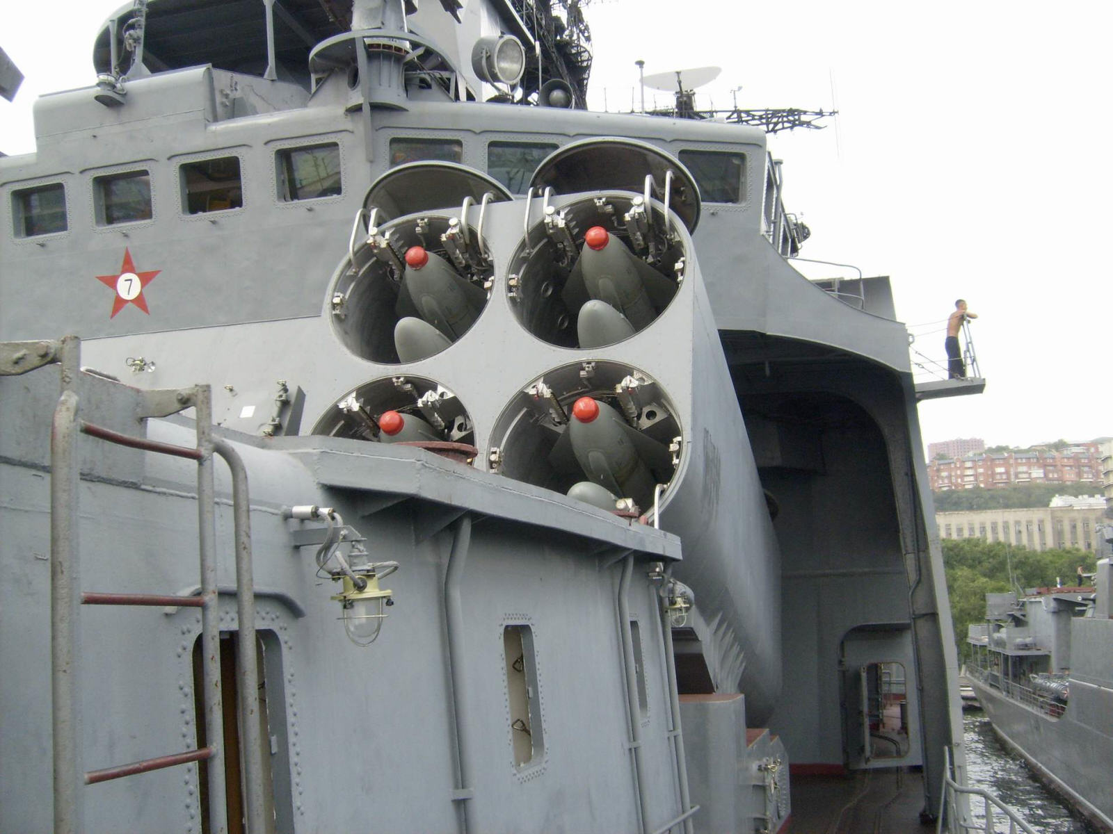
SS-N-14 Silex missile
‘Metel’ (snowstorm) launcher
1969 entered service in Russian navy
Solid fuel rocket motor
10 – 90km Anti-ship range
5 – 50km ASW range
Nuclear capable
Torpedo or High Explosive payload

Slide 11
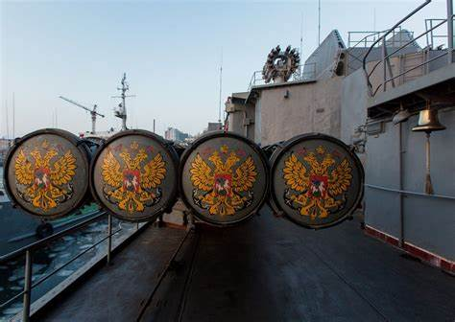
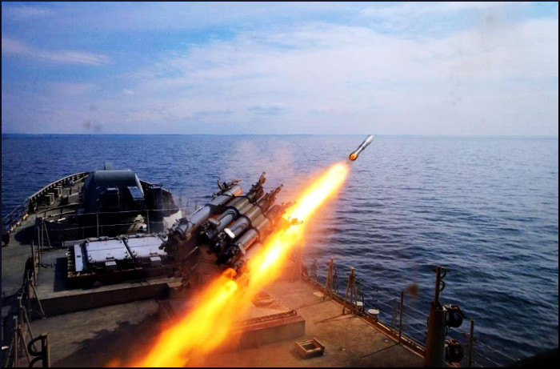
Other ASW weapons
2x4 53cm torpedo tubes
Type 53 and type 65 ASW torpedoes
50 km range
50 knots
2x RBU-6000 (12000 udaloy II)
Rocket bomb unit
43-pound shaped charge

Slide 12
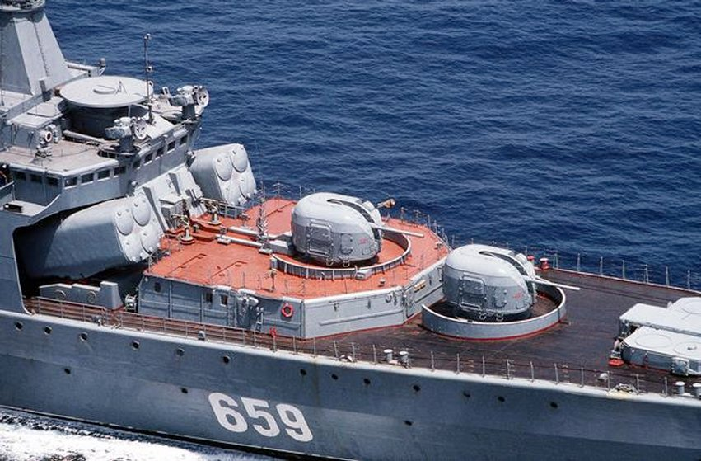
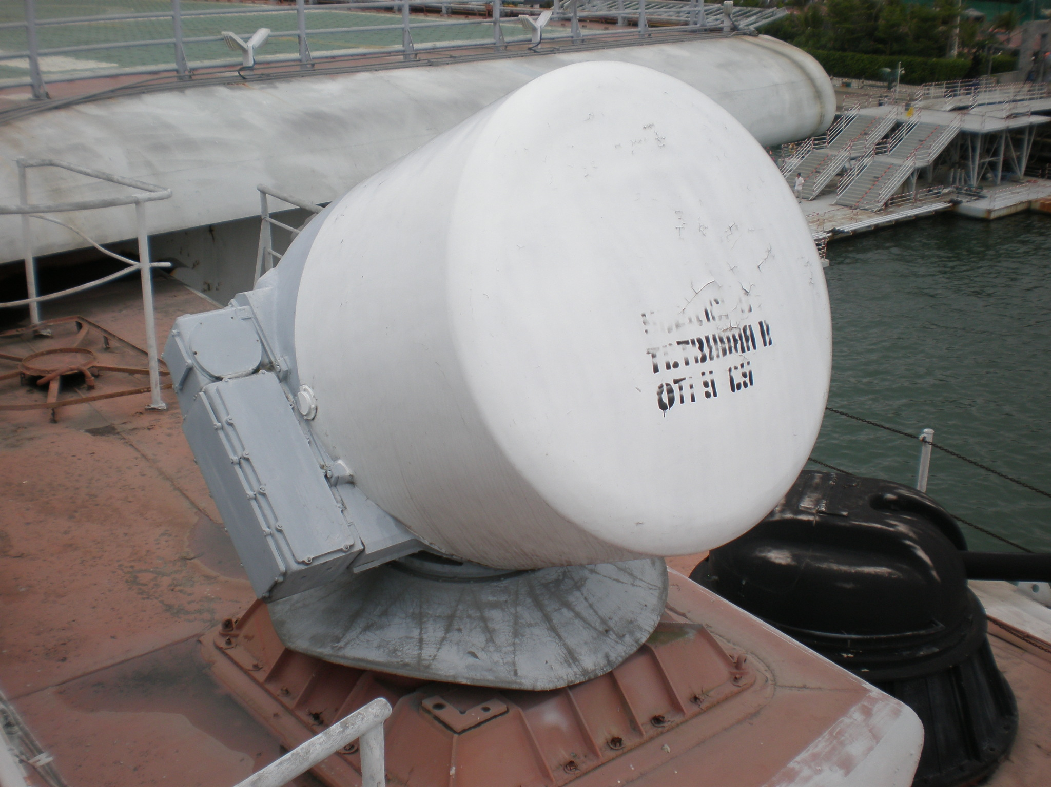
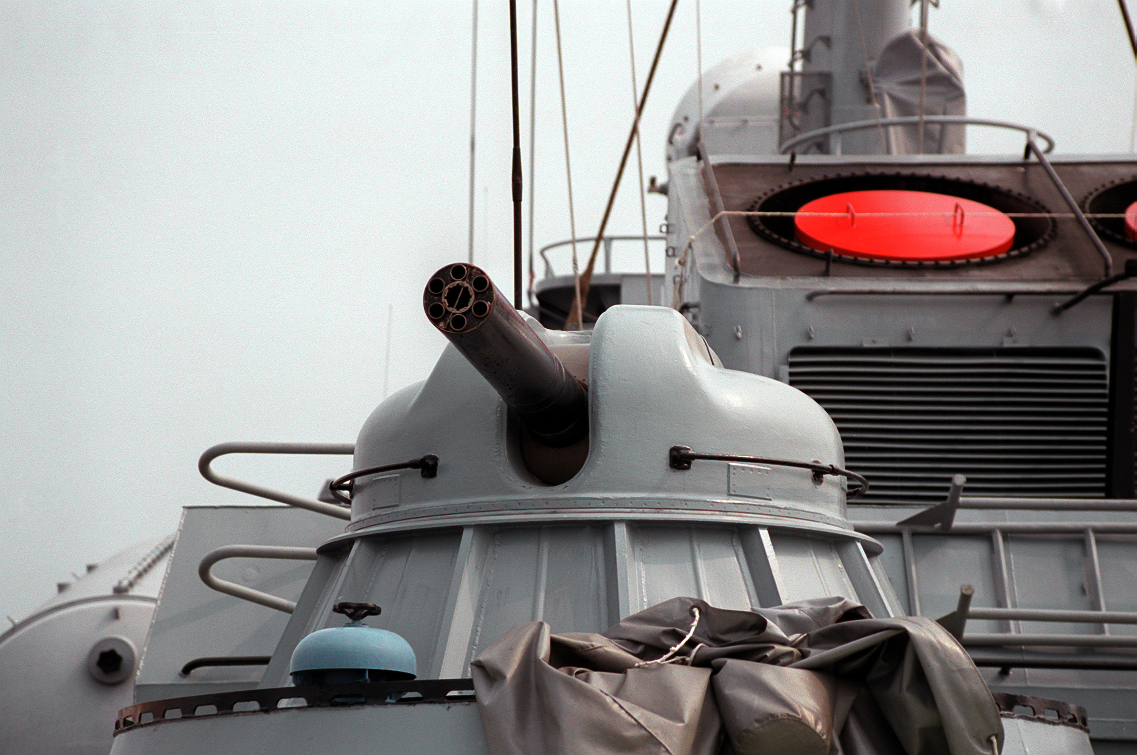
Naval guns
2x AK-100mm dual purpose cannons
60 rounds/min
27kg (~59 pound) HE shell
4x AK-630 close in weapon system
6-barrel rotary cannon
30mm shell
Radar directed by MR-123 system

Slide 13
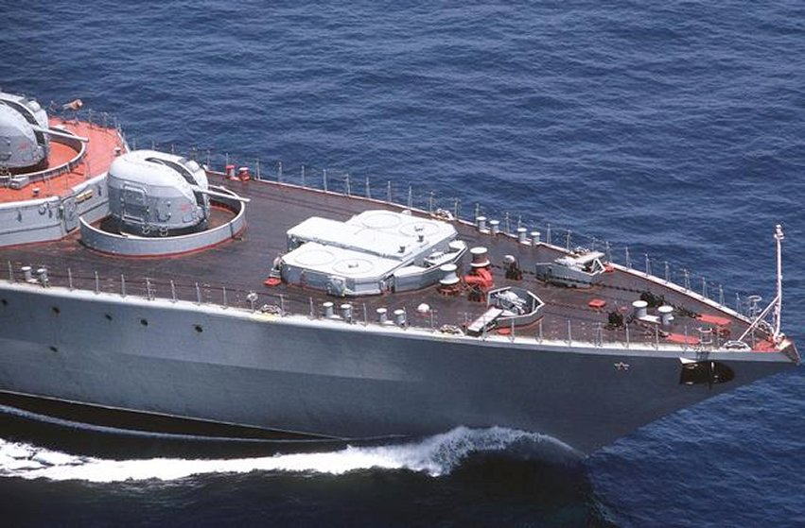
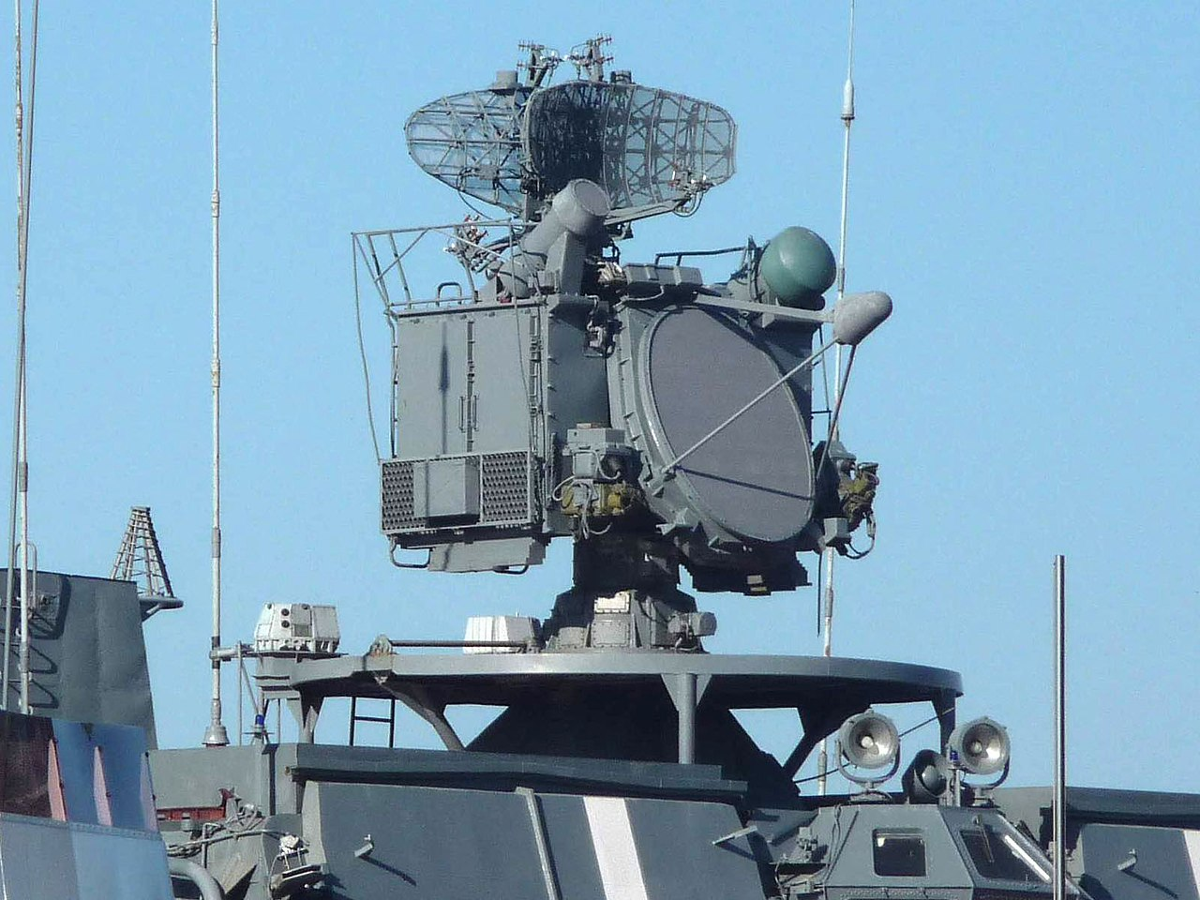
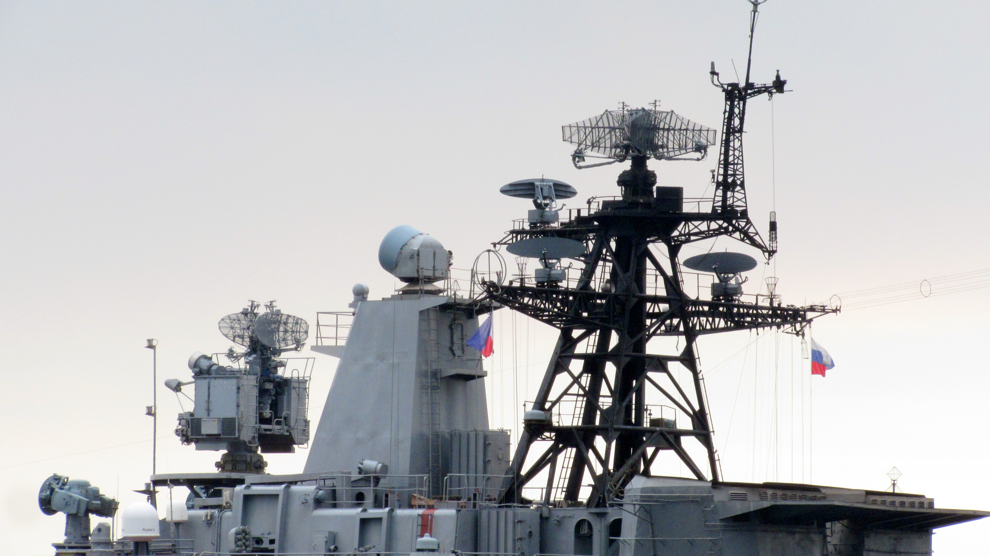
Anti-air weapons and Fire control
SA-N-9 Gauntlet missile ‘dagger’
8x vertical launchers
9-mile effective range
Highly lethal
3R95 Fire Control Radar
“Cross Swords”
28-mile range

Slide 14
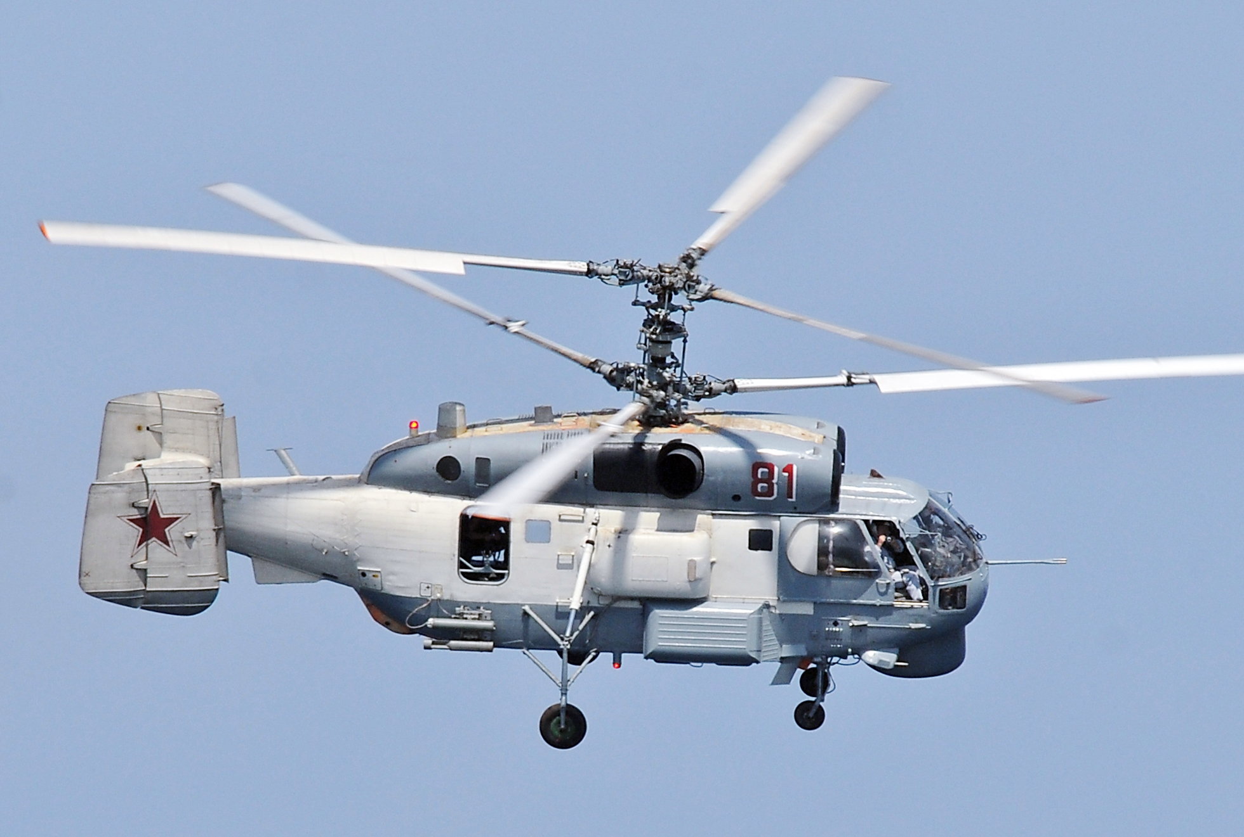
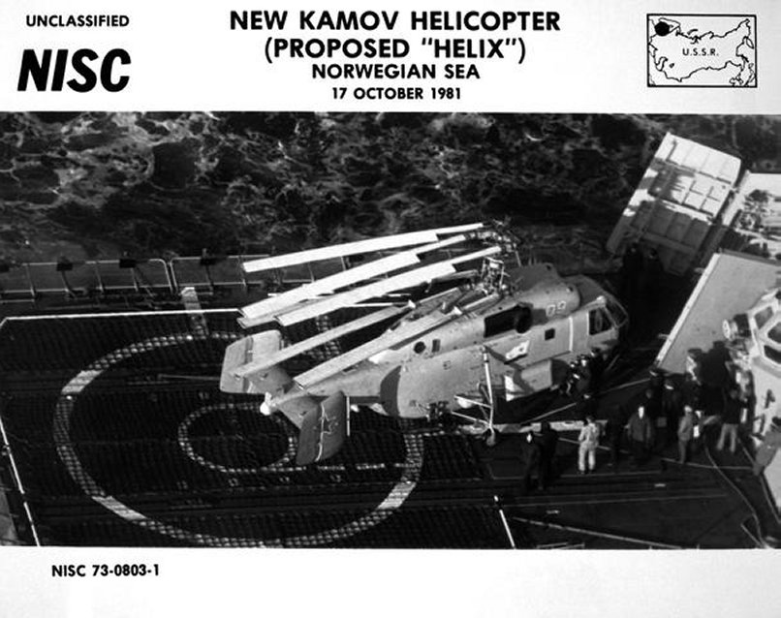
Ka-27 Helix
Replaced the KA-25 Hormone in 1982
Twin engine
Coaxial rotor removes need for tail rotor
150 kts for 500 miles
Naval variants includes radar, ESM, sonar and MAD systems
Drops torpedoes and sonobuoys for ASW warfare

Slide 15
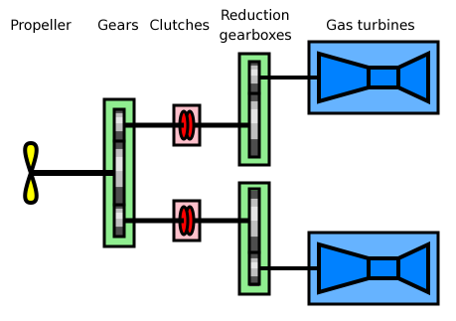
COGAG combined Gas turbine and Gas Turbine
Two gas turbines per shaft
Gas turbines are most efficient operating at near max capacity
Cruise turbine runs continuously at full power
high pressure “boost” turbine is added for high-speed operations
60,000 shaft horsepower (each shaft)

Slide 16
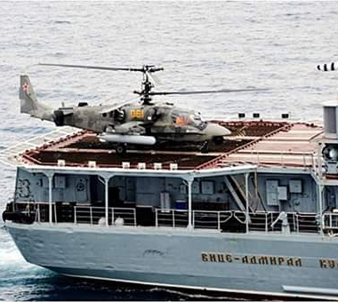
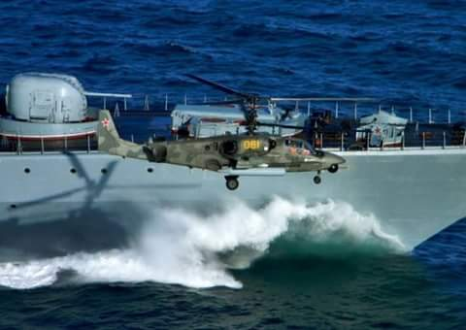
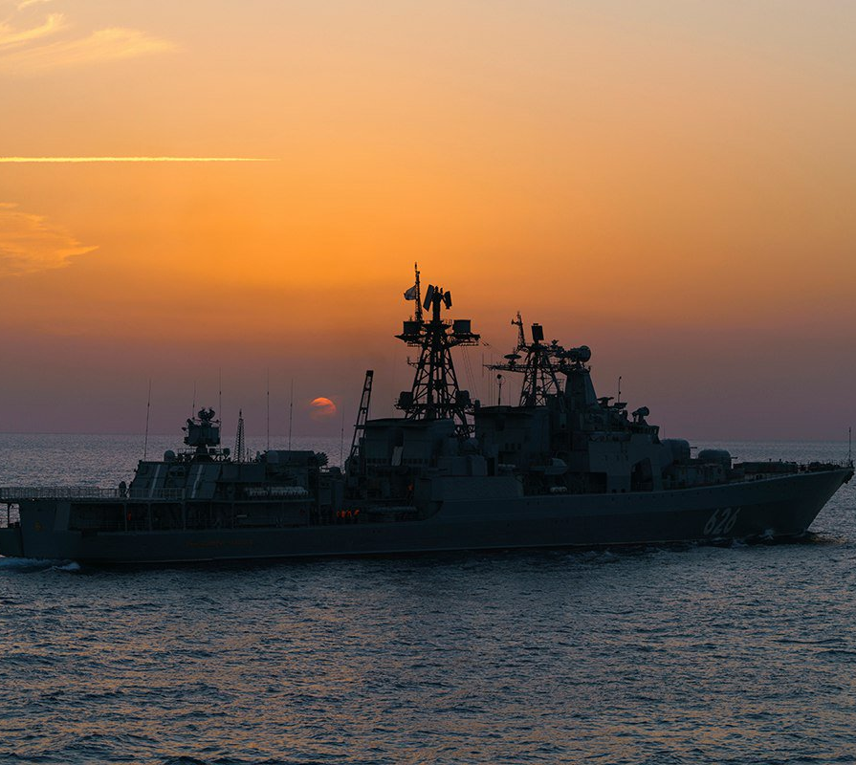
Vice-Admiral Kulakov
Keel laid 4 November 1977
Launched 16 May 1980
Commissioned 29 December 1981
Drydocked for repairs 1991
Return to service in 2010
2011 fire minor damage in port
2011 tested new KA-52 Helo

Slide 17
Vice-Admiral Kulakov
2012 Anti piracy deployment to gulf of Aden, UK visit
2014 deployed to Norwegian sea
2016 Med. Sea tour
2018 sailed northern sea route to Pacific fleet
2020 deployed to med. Sea
2021 in service in Northern Fleet

Slide 18
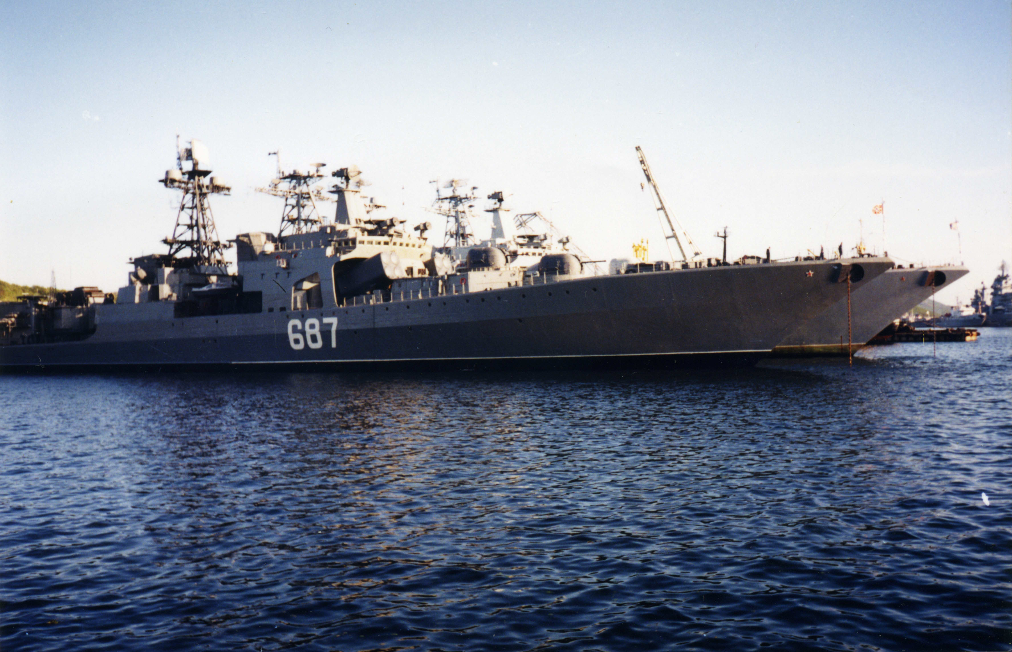
Marshal Vasliyevsky
Keel laid 22 April 1979
Launched 19 December 1981
Commissioned 8 December 1983
Assigned to Northern Fleet 1984
Multiple North Atlantic deployments during the 80’s and 90’s
1997 tracked a foreign submarine in the Barents Sea
Did not sail again
2006 Ship is removed from active service

Slide 19
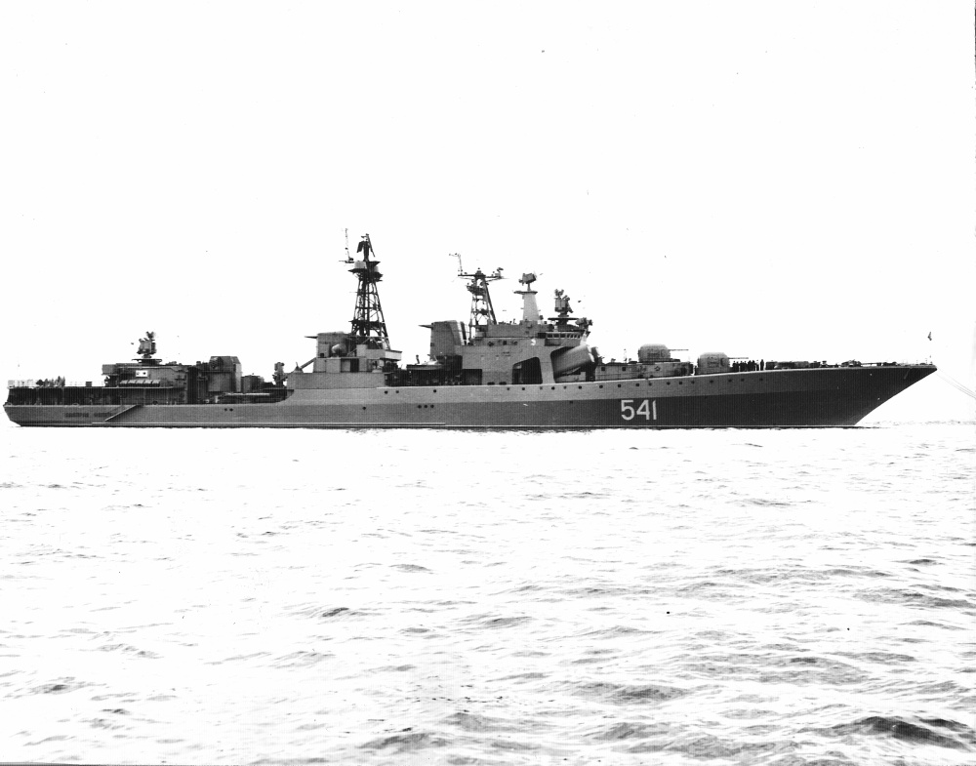
Admiral Zakharov
Keel laid 16 October 1981
Launched 4 November 1982
Commissioned 8 December 1983
Awarded best in Baltic Fleet 1985
1987 Transit to Pacific fleet via Indian Ocean
1988-89 deployment to North Korean port and Persian Gulf
1990-91 deployed to South China Sea
February 1991 explosion in the engine room destroyed on gas turbine and killed a sailor
Fire burned for 30 hours
1994 repairs deemed too costly and moved to Chash mnsky shipyard for disassembly

Slide 20
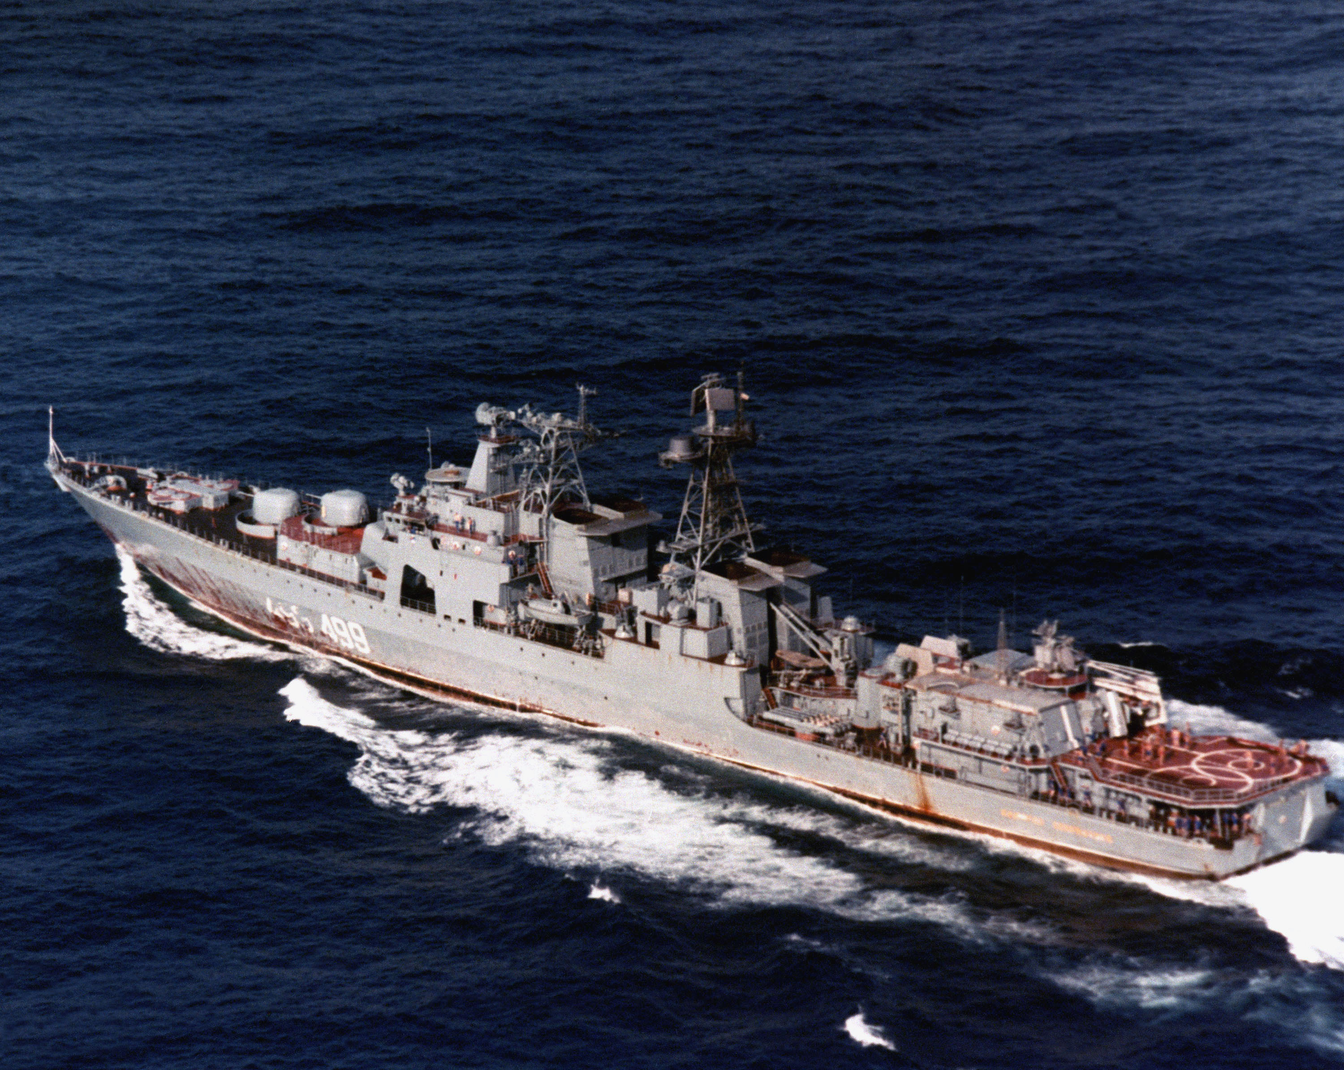
Admiral Spiridonov
Keel laid 11 April 1982
Launched 28 April 1984
Commissioned 30 December 1984
1985 Assigned to pacific fleet
1986 Naval exercises in Sea of Japan
1989 Deployed to Persian Gulf
90’s deployment to Indian ocean with African port visits
2001 decommissioned and scrapped

Slide 21
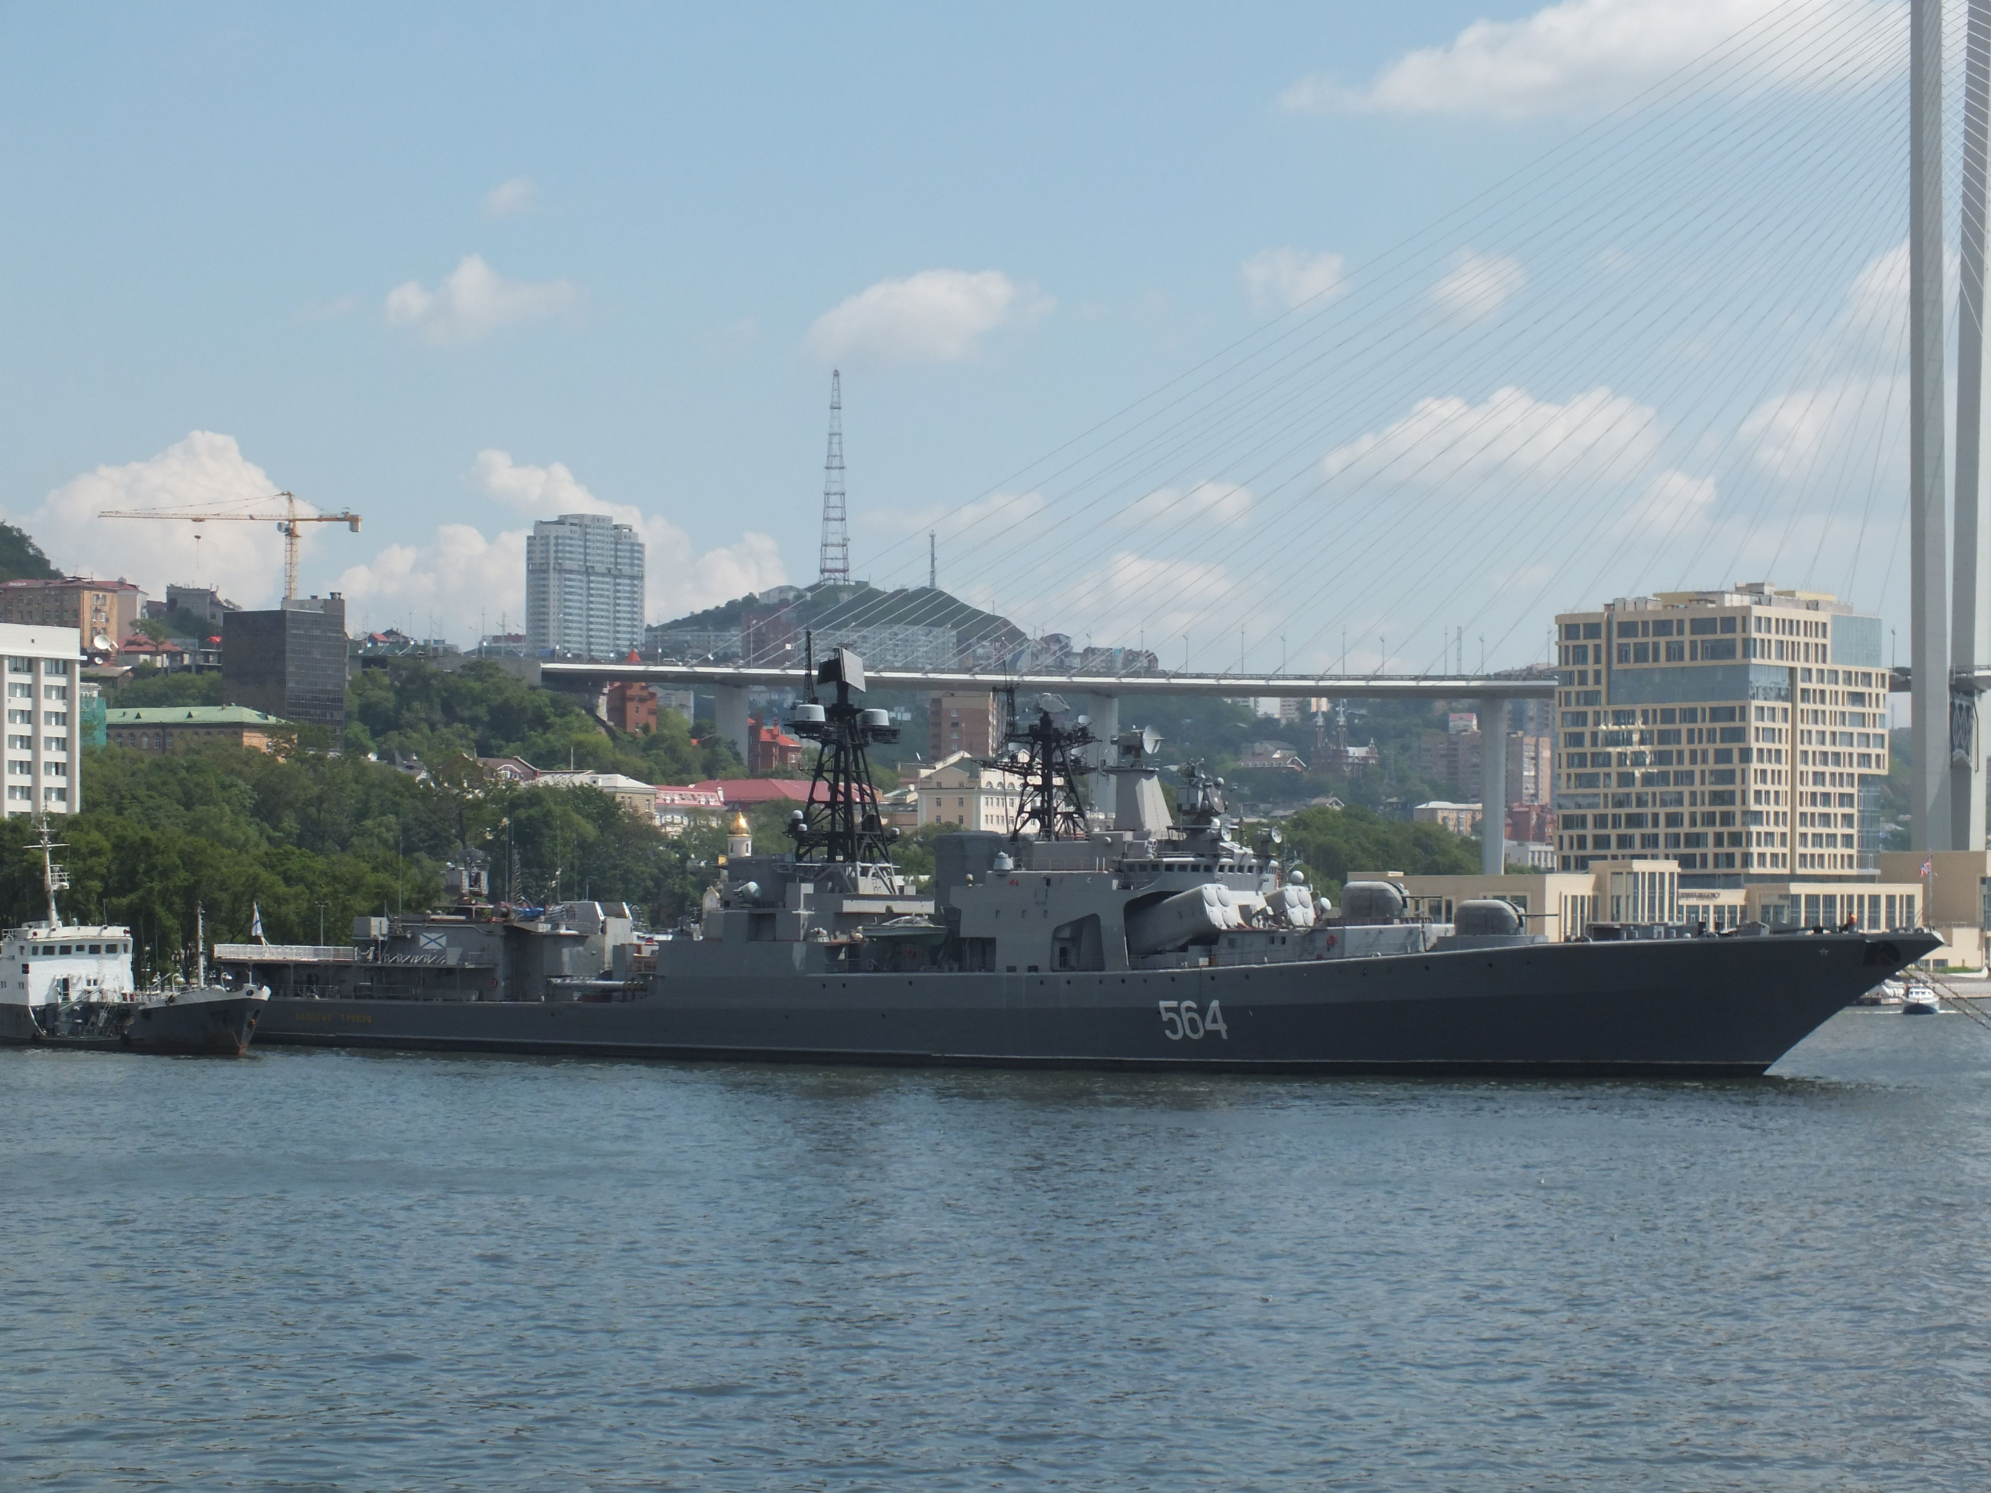
Admiral Tributs
Keel laid 19 April 1980
Launched 26 March 1983
Commissioned 30 December 1985
1986 Assigned to Pacific Fleet
Deployed along side Chinese and Indian fleets in the 80’s
1992-93 Persian Gulf deployment
1994-2003 Drydock and modernization
2005 Naval exercises with India and Japan
Active service in the Pacific fleet continues today

Slide 22
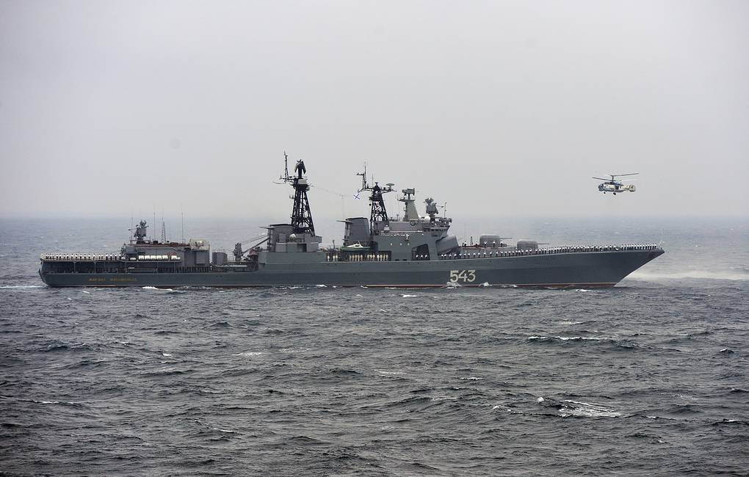
Marshal Shapohnikov
Keel laid 25 May 1983
Launched 27 December 1984
Commissioned 30 December 1985
1986 assigned to Pacific fleet
1990’s various Pacific deployments
2003 deployed to Indian ocean
2010 rescued a hijacked cargo ship off the coast of Somalia
2014 deployed near Australia
2017 drydock for modernization
2018 Fire in drydock damaged systems

Slide 23
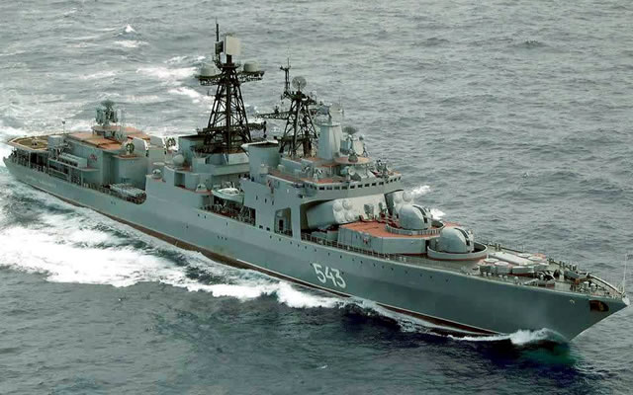
Marshal Shaposhnikov
Before MOdernization
2015 Russia announced it would upgrade 5 Udaloy’s
Extended service life 30 years
Replace ASW missiles with anti ship missiles
Replace one deck gun with a VLS launcher
100mm gun
Silex

Slide 24
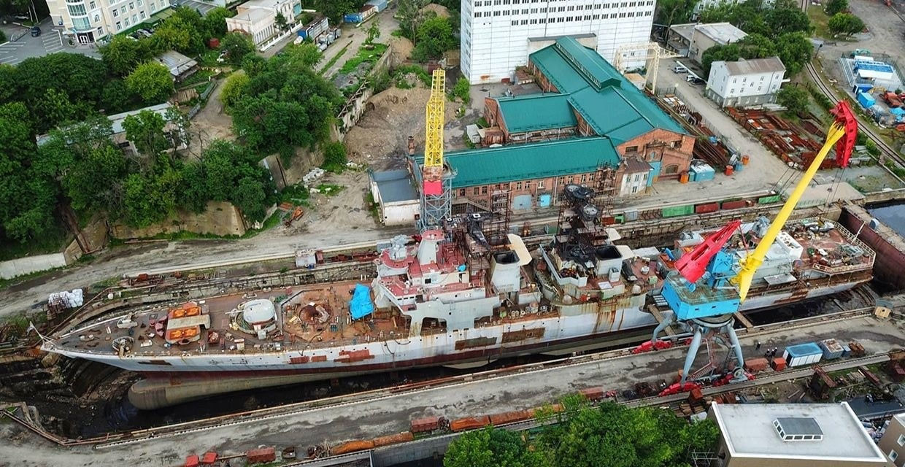
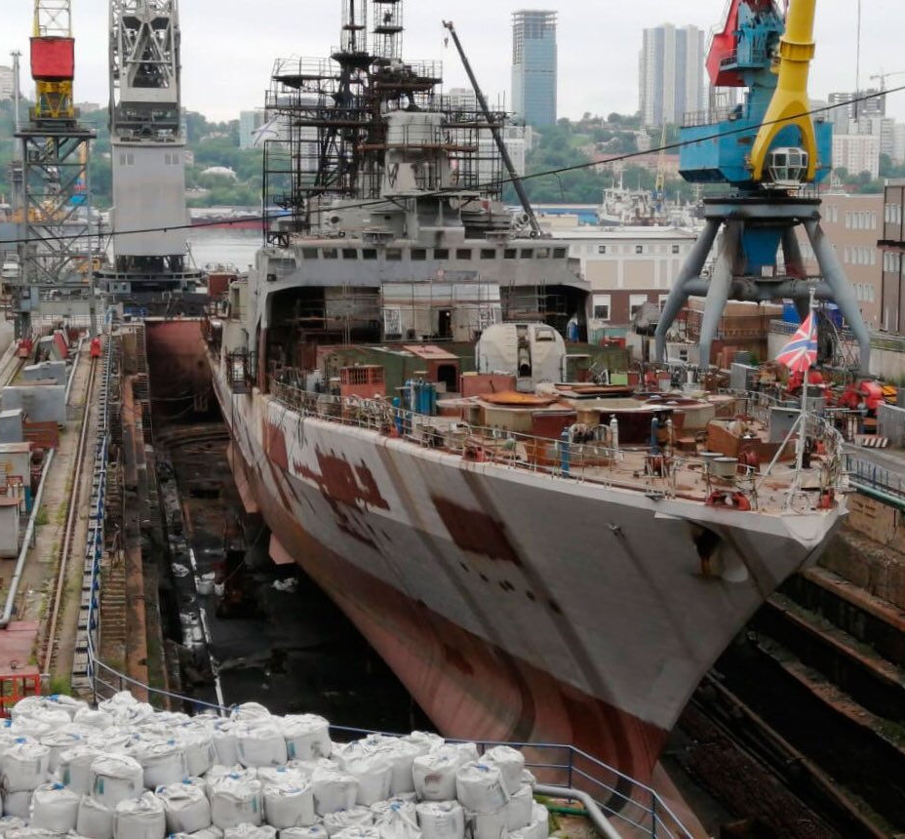
rearmament of Marshal Shaposhnikov
Vladivostok, Russia
Switchblade
Anti ship missiles
Kaliber
VLS launcher

Slide 25
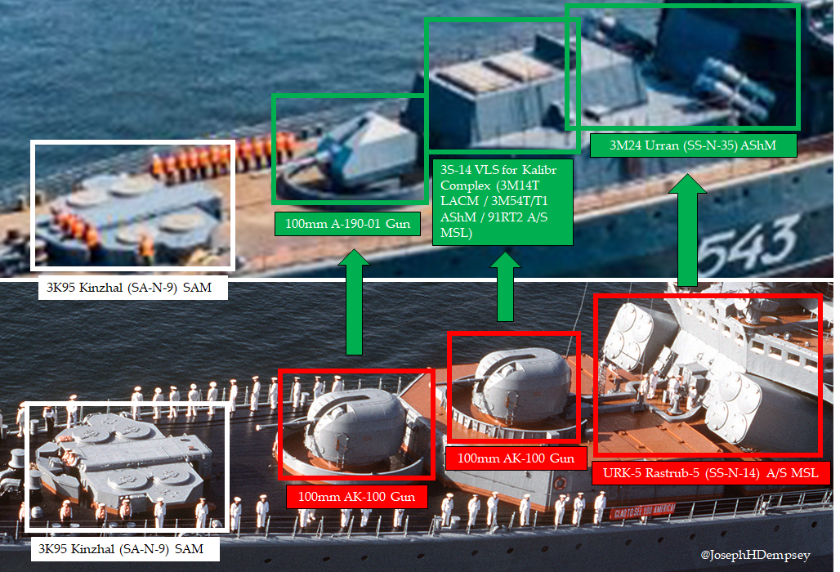
2021

Slide 26
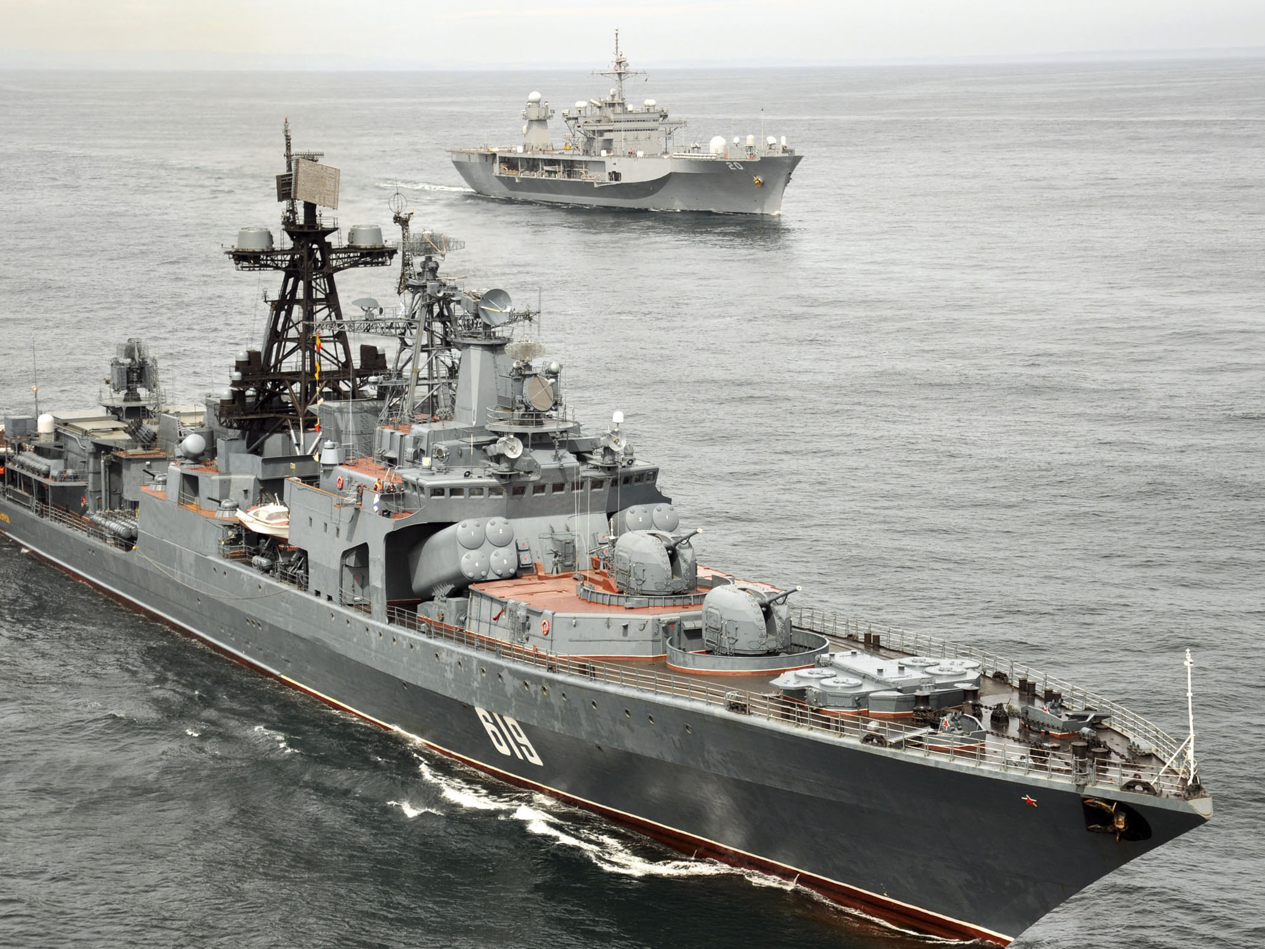
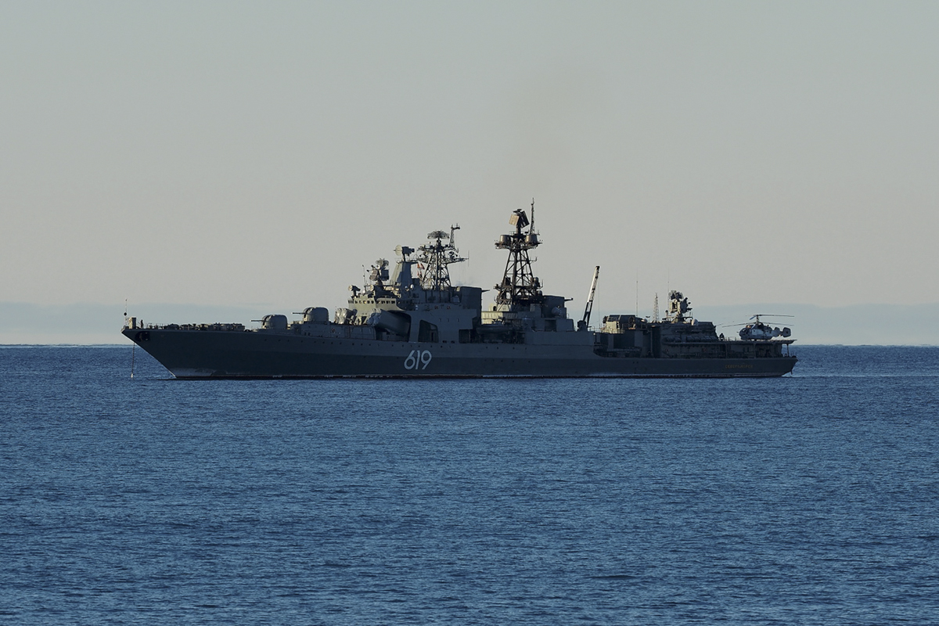
Severmorsk
Keel laid 12 June 1984
Launched 24 December 1985
Commissioned 30 December 1987
1988 Assigned to Northern Fleet
1990-2000’s no public service record
2017 completed Arctic Ocean Exercise
2018 Anti-Piracy deployment in Gulf of Aden
2019 Med. Sea deployment
2020 deployed off the coast of Alaska
2021 Naval exercise in Barents Sea

Slide 27
Admiral Levchenko
Keel laid 27 January 1982
Launched 21 February 1985
Commissioned 30 September 1988
1990-2000’s No deployment data
2010 Anti-piracy deployment off Somalia
2018 Navy Day Parade in St. Petersburg
2020 place on inactive list possible waiting for modernization to Udaloy II

Slide 28
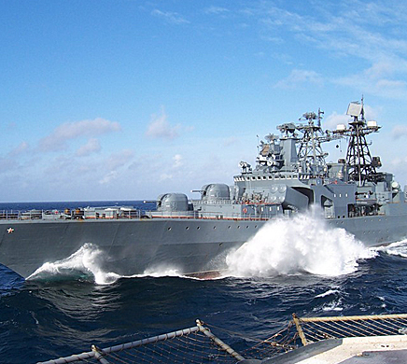
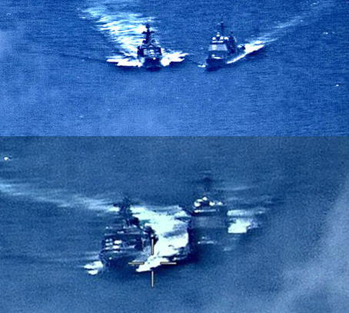
Admiral Vinogradov
Keel laid 5 Febrary6 1986
Launched 4 June 1987
Commissioned 30 September 1988
1989 assigned to pacific fleet
1990 visited San Diego
1992 Persian Gulf deployment
2010 Anti-piracy deployment Gulf of Aden
2019 near-collision with USS Chancellorsville in the South China Sea
2021 Active duty in the Pacific Fleet

Slide 29
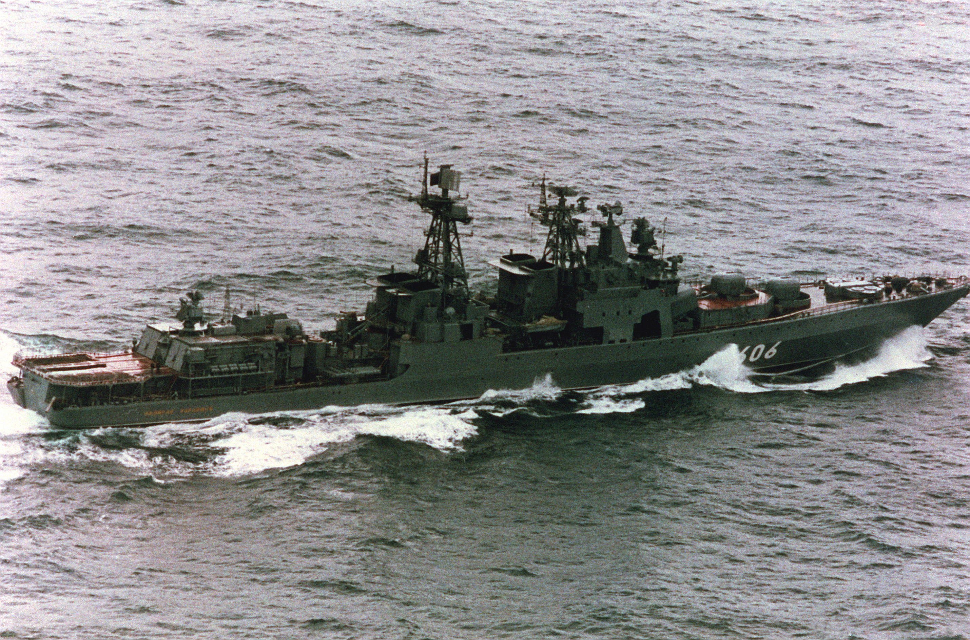
Admiral Kharlamov
Keel laid 8 July 1986
Launched 29 June 1988
Commissioned 30 December 1989
1993 visited Halifax and Boston
1994 visited Rotterdam
1996-97 Best ASW ship in fleet
2001 Naval exercise, search for Kursk
2006 removed from active service
2019 waiting for dismantle / disposal
2020 formally decommissioned

Slide 30
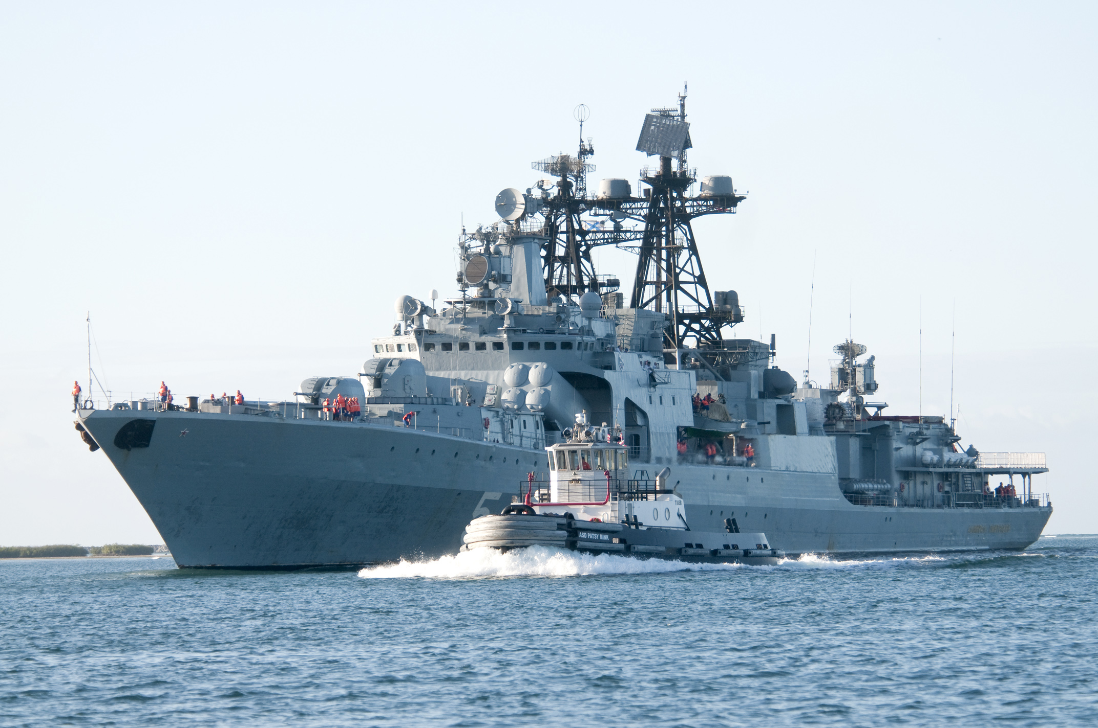
Admiral Panteleyev
Keel laid 28 January 1988
Launched 7 February 1990
Commissioned 19 December 1991
1992 assigned to Pacific fleet
2009 anti-piracy deployment off Somalia
2012 participated in U.S. led RIMPAC naval exercise
2017 port visit to Manila
2021 Active duty in the Pacific Fleet

Slide 31
Admiral Chabanenko
Udaloy II
Keel laid 28 February 1989
Launched 16 June 1994
Commissioned 28 January 1999
2000 assigned to the Northern Fleet
2008 sailed the Panama Canal
2009 Anti-piracy patrol near Somalia
2011 joint naval exercise with NATO countries
2013 drydocked for overhaul
2021 Remains in drydock at Murmansk, Russia

Slide 32
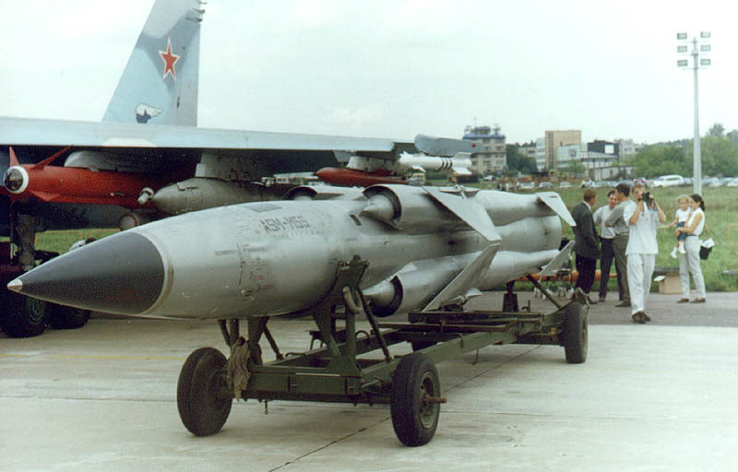
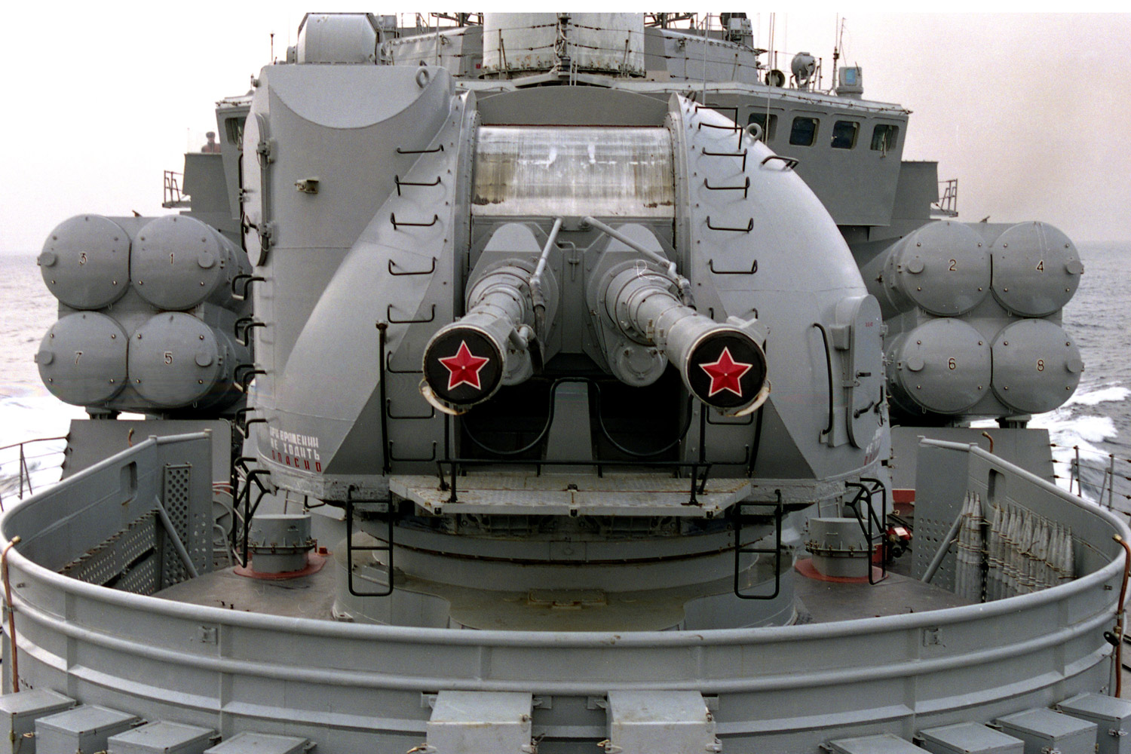
Udaloy II upgrades
SS-N-22 ‘Sunburn’ Anti ship missile
Mach 3 speeds
150 miles
Nuclear capable
2x quad launchers facing forward
Zvezda M-2 sonar system
Improved Horse Jaw
120km range scale
1.5 degree bearing accuracy
VDS to 400 meters
AK-130
130mm dual cannon

Slide 33
Final thoughts
The only surface ASW vessel I feared
Very capable Horse Jaw sonar suite
Very fast, reliable ship
Weak Anti-ship and Anti-air weapons
Absolute icon of the Cold War
With Modernization, can compete in the 21st century

Slide 34


Department Heads
Division Officers
Alexander Huff
Brendan Ferry
Chappy James
Jason Wang
Jeremy Edwards
Joel Corrente
DJS4000
Jordan Vodrazka
Josh Warrick
Nathaniel Wilbanks
Robby Stahl
Scott Borg
Sean O’Neil
Adam Morgan
Harpoon Henry
JB
Kelly Martin
William R. Collier Jr.

